Slide 1

Johannes Itten
Color Theory

Slide 2
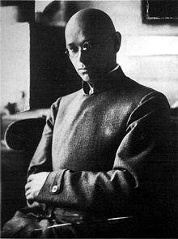
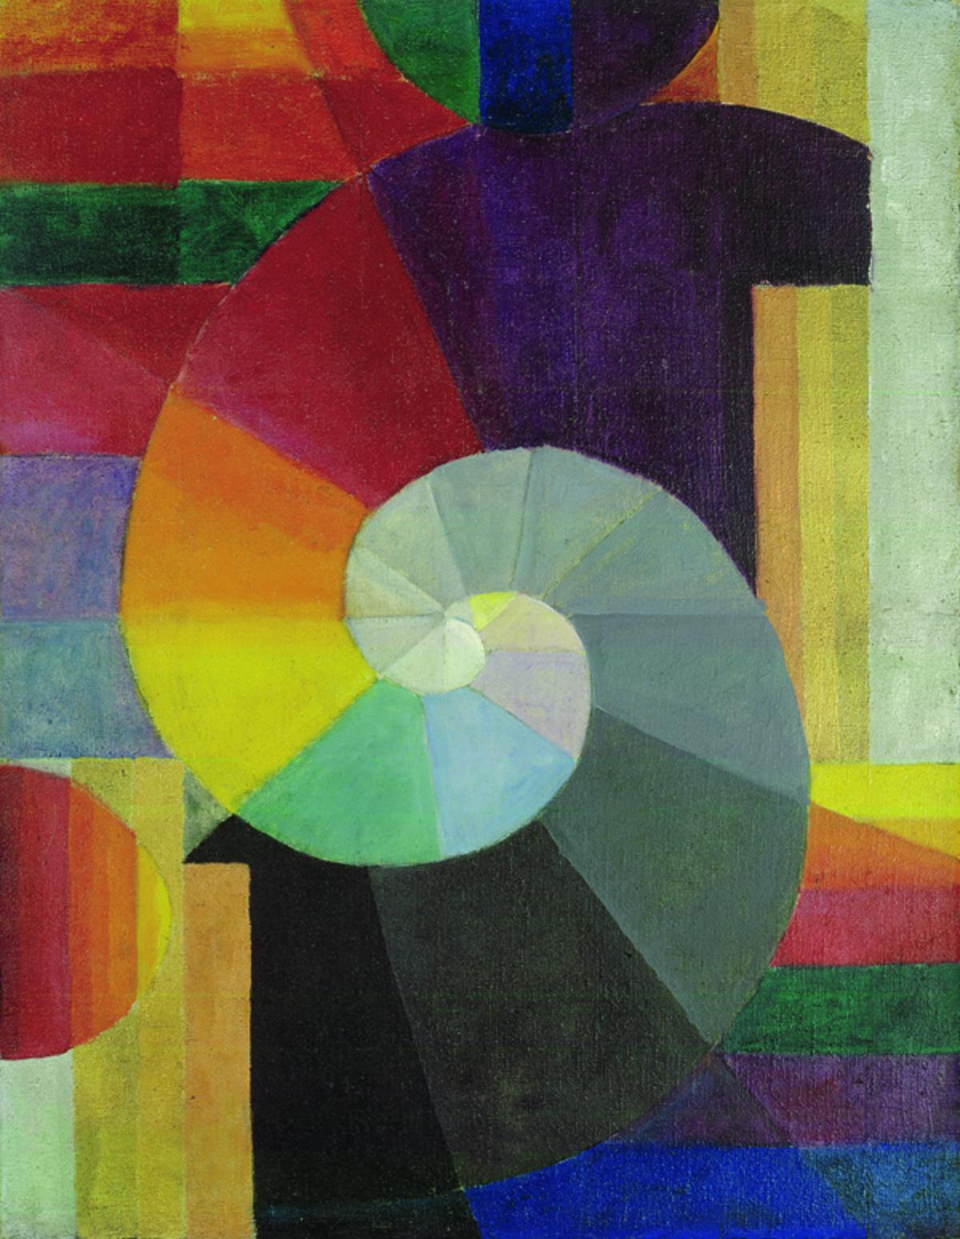
Who was Johannes Itten?
A Swiss artist born in 1888.
Trained as a school teacher, then studied art.
Part of the Bauhaus (pronounced bow-house) School in Germany.
  The Bauhaus focused on “form follows function”
Developed the modern color wheel
Notes:
Images from
https://upload.wikimedia.org/wikipedia/commons/thumb/5/57/Itten001.jpg/220px-Itten001.jpg
https://uploads6.wikiart.org/images/johannes-itten/farbformen-und-struktuten-1953.jpg!PinterestSmall.jpg
https://www.bauhaus100.de/bh100/export/sites/default/de/damals/werke/malerei/die-begegnung/die_begegnung_0.jpg_1373974208.jpg
https://images.fineartamerica.com/images-medium-large-5/circles-by-johannes-itten-stefano-baldini.jpg
https://i.pinimg.com/736x/3f/68/ef/3f68ef1b8041ad1deb1411146807857f--johannes-itten-art-kids.jpg

Slide 3
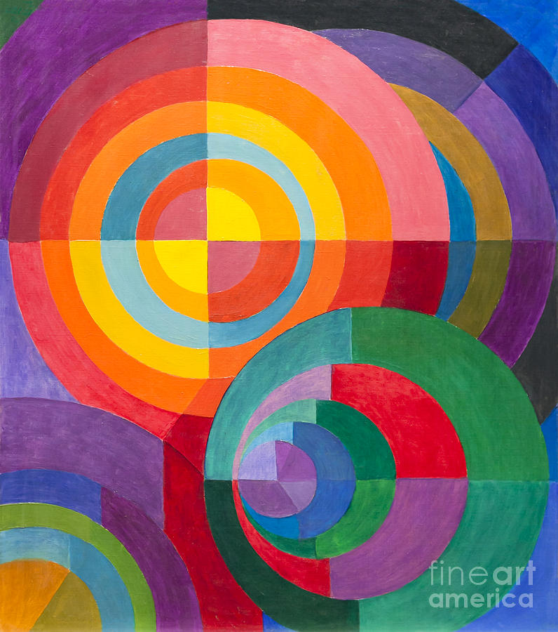

Slide 4
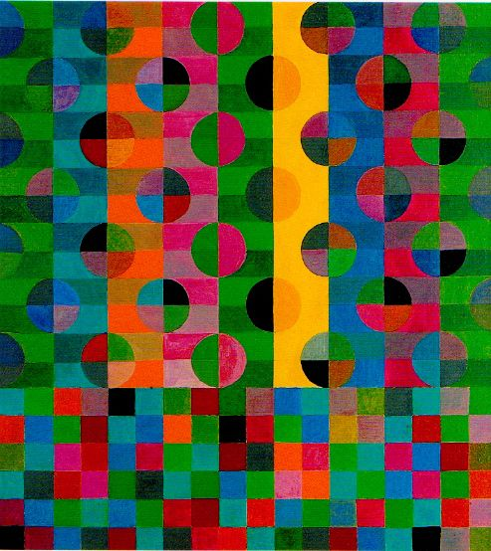

Slide 5
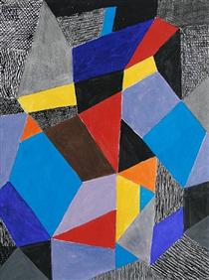

Slide 6
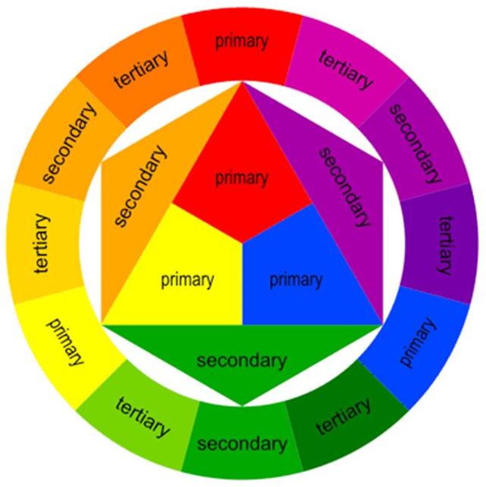
Complementary colors are:
Primary + Secondary colors on opposite sides of the color wheel, they make each other stand out.
Can you find the 3 pairs?
Notes:
Image from http://images.slideplayer.com/31/9639050/slides/slide_1.jpg

