Slide 1
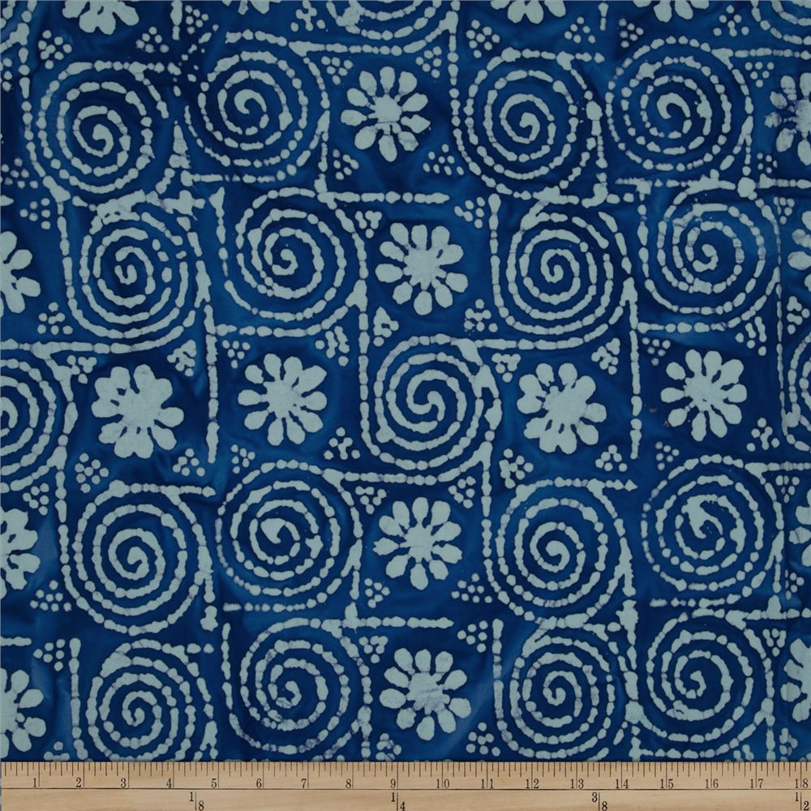
Indian Batik

Slide 2

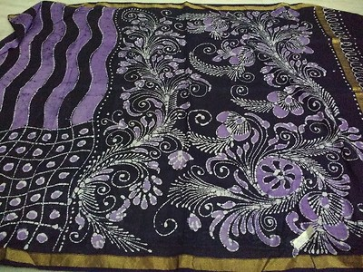
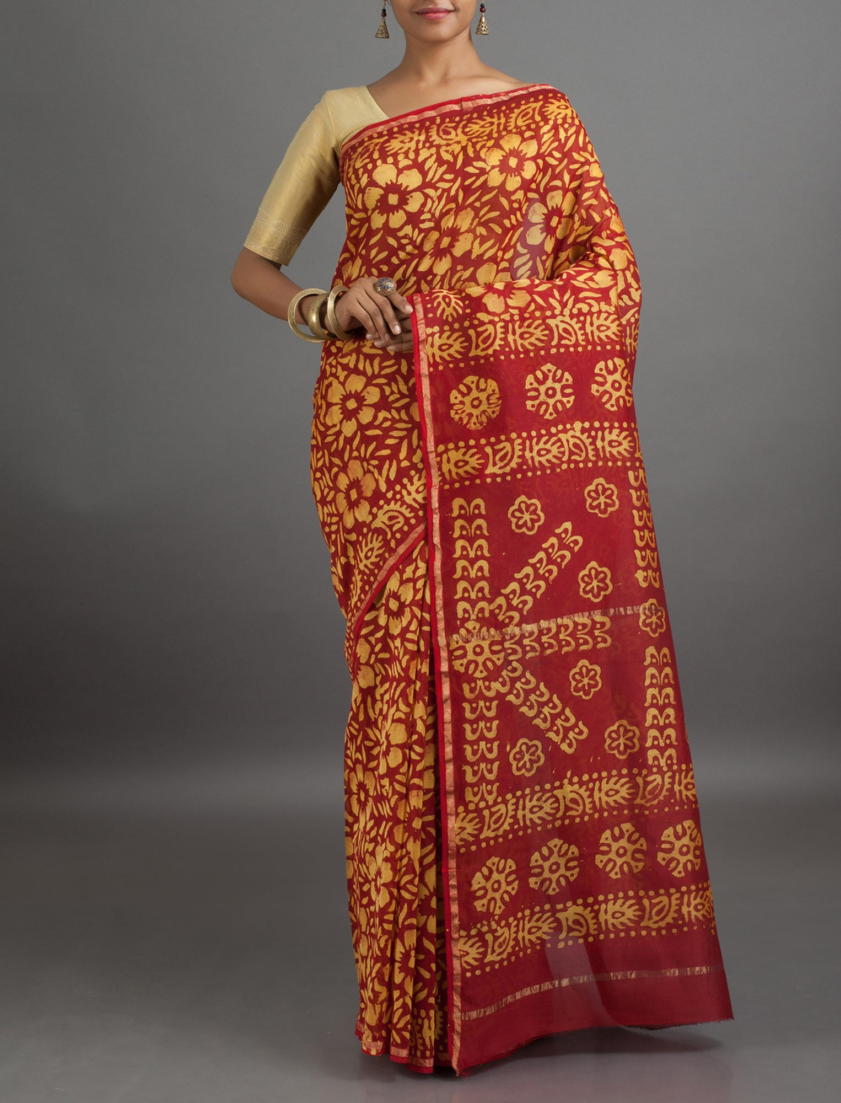
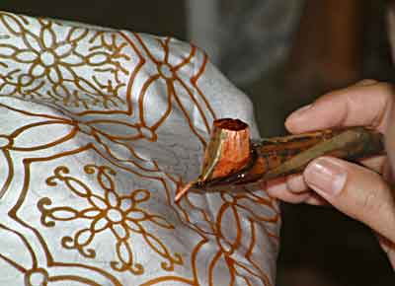
What is batik?
Using wax to block out parts of color on a design; also called wax-resist dyeing
An ancient art form
Used as decoration and for traditional Indian sari

Slide 3
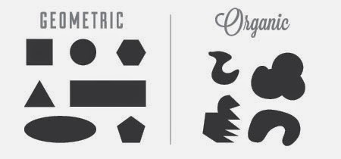
Notes:
Image from: http://2.bp.blogspot.com/-lW09WC4ywxc/VGZS0eOO8TI/AAAAAAAAAmU/k5qZSY-nwnQ/s1600/shape_example.jpg

Slide 4
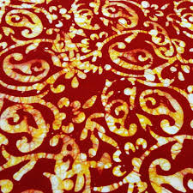
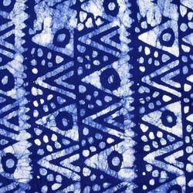
Where do you see organic shapes? How about geometric?

