Slide 1
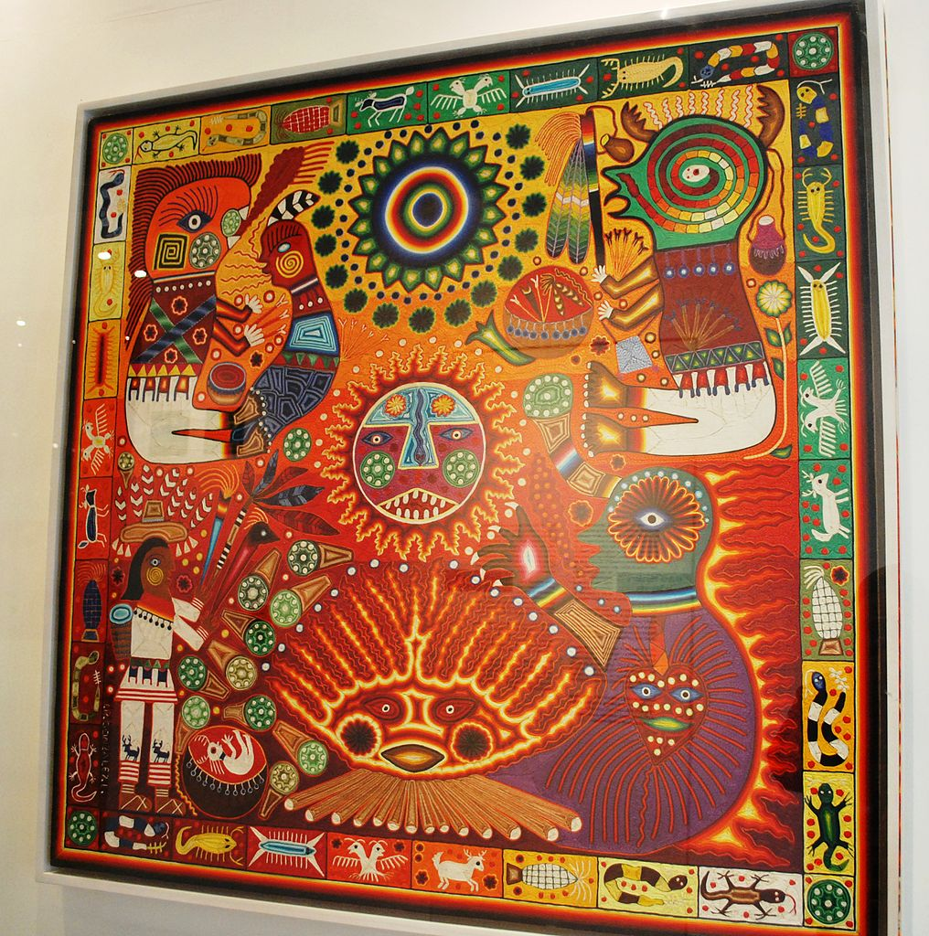
Mexican Yarn Painting

Slide 2

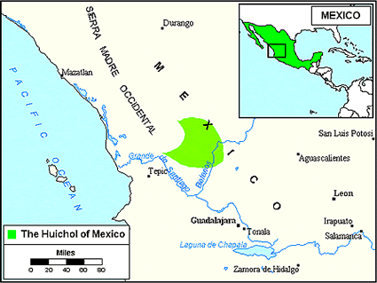
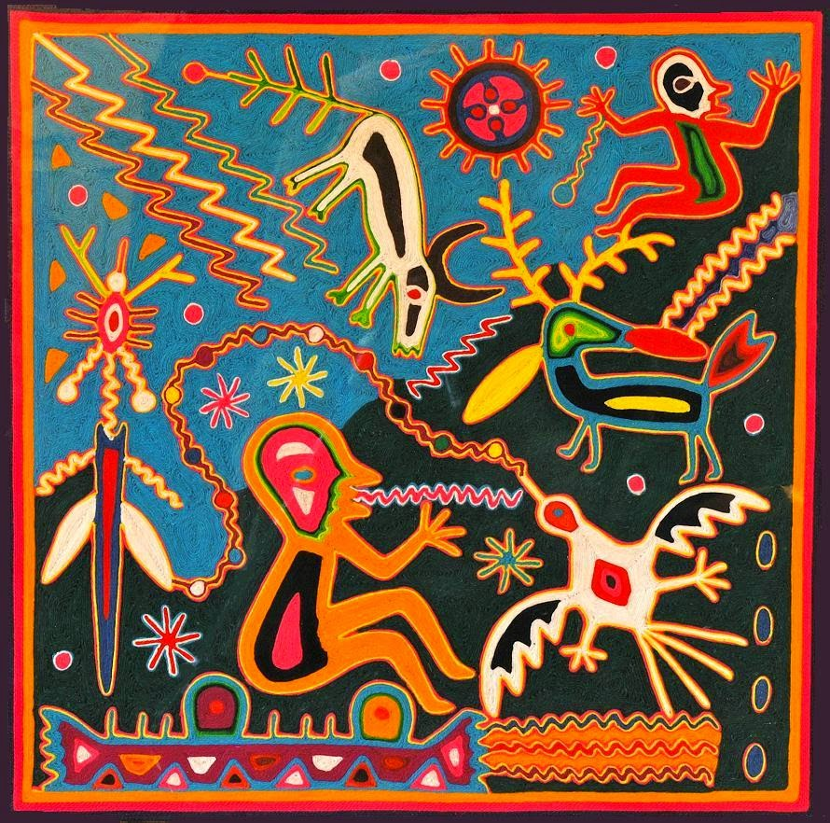
A Brief History
Style invented by the Huichol (pronounced Wettchol) people of Western Mexico
Yarn paintings are actually called Nierkas (pronounced Near-eeka)
Notes:
Facts from http://www.waunakee.k12.wi.us/faculty/swagner/newsfile12760_1.pdf

Slide 3
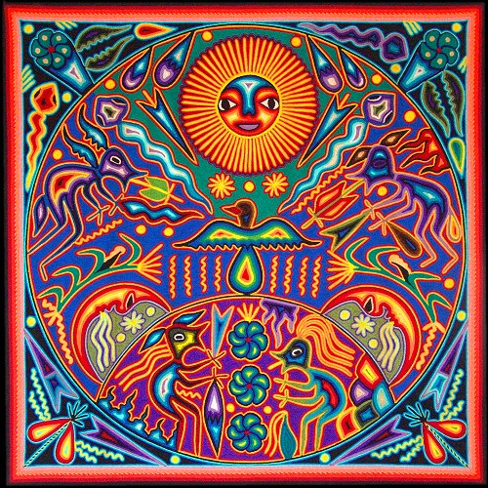
What did they show?
Symbols based on myths, stories, and daily activities.
Nature motifs are common.
What symbols would YOU use?

Slide 4
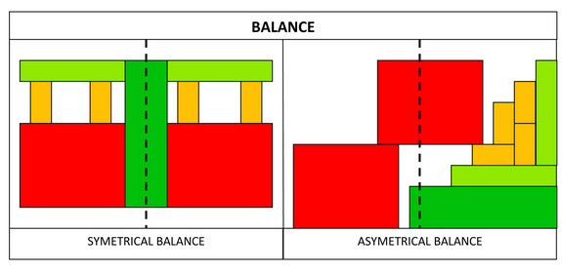
Balanced Composition
Notes:
Image from https://www.sophia.org/download/ckeditor%2Fpictures/2918/data/content/BALANCE.jpg?1310620499

Slide 5
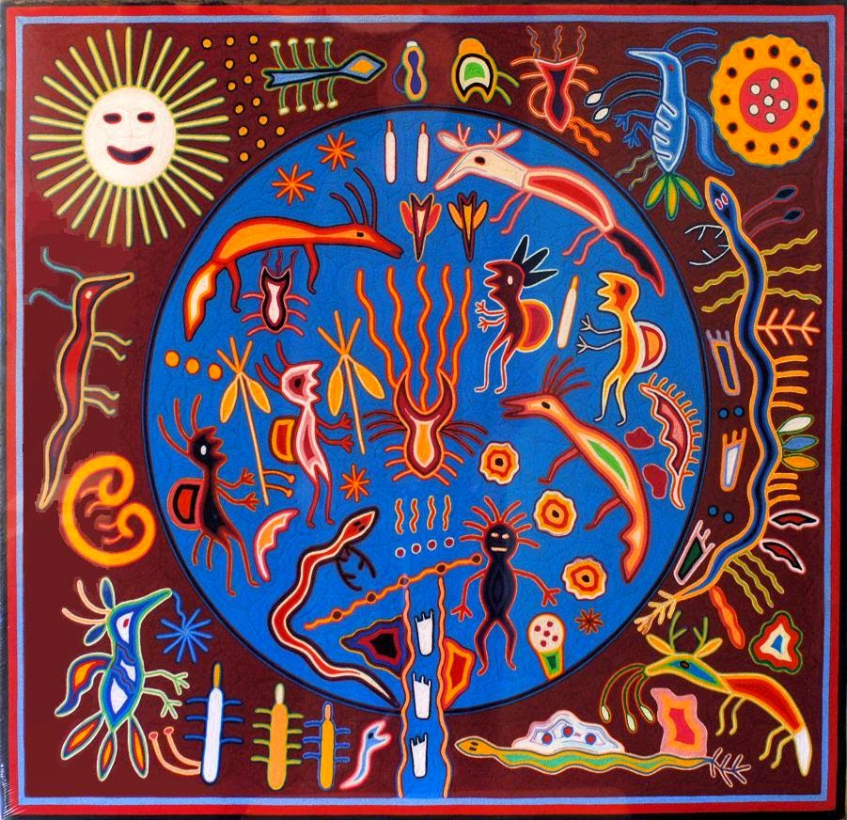
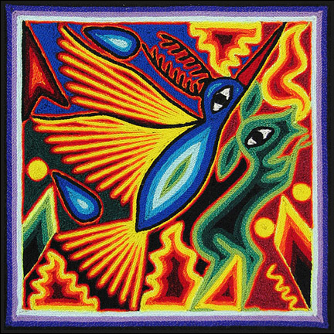
Asymmetrical or Symmetrical
Balance?

