Slide 1
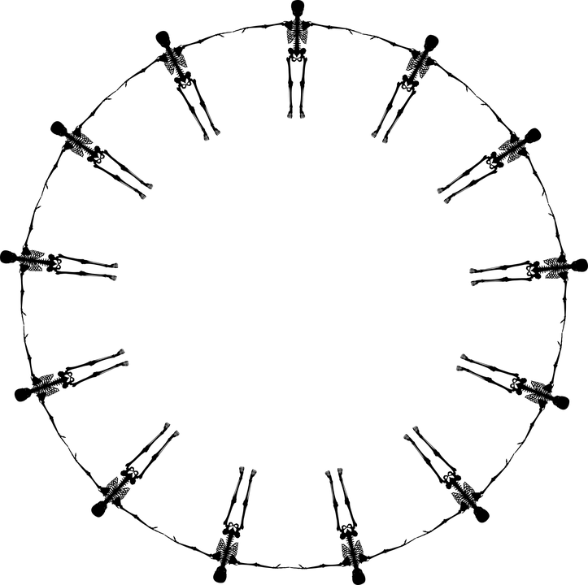
Exquisite Corpse

Slide 2
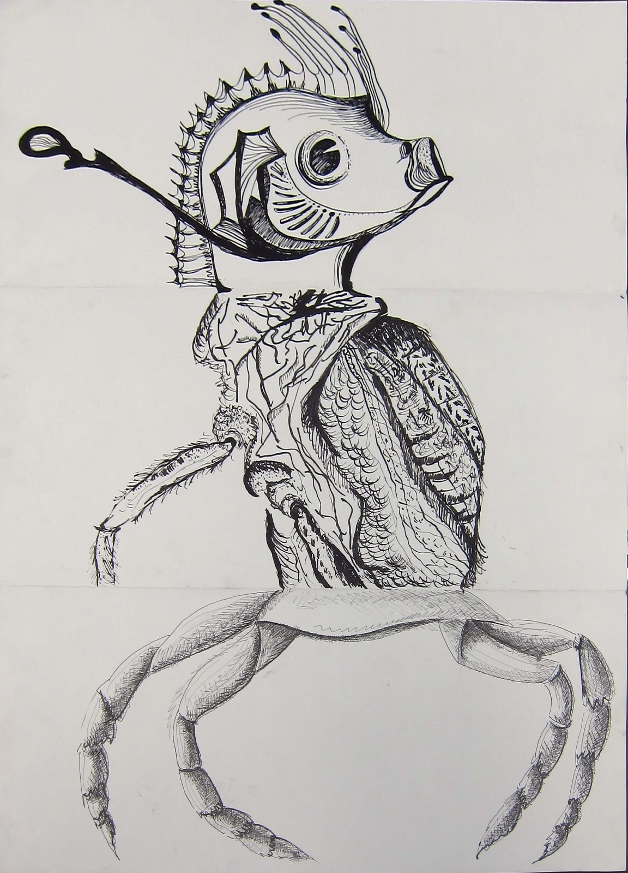
Surrealist “Exquisite Corpse”
Based on an old parlor game, Exquisite Corpse was played by several people, each of whom would write a phrase on a sheet of paper, fold the paper to conceal part of it, and pass it on to the next player for his contribution.
We will do this...with drawing to create Surrealist, dream-like creatures!
Notes:
http://2.bp.blogspot.com/-sfMj2GLQtLo/UI_RKWdGQLI/AAAAAAAABQA/W251y9048_U/s1600/crablegs.jpg

Slide 3
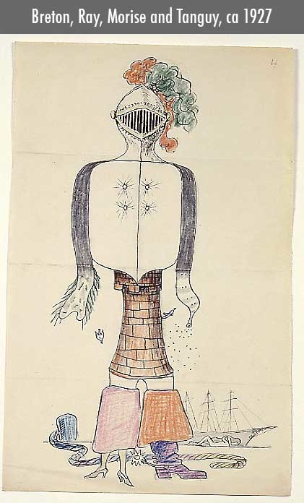
Notes:
http://www.exquisitecorpse.com/images/corpse%20-%209.jpg?crc=3897469714

Slide 4
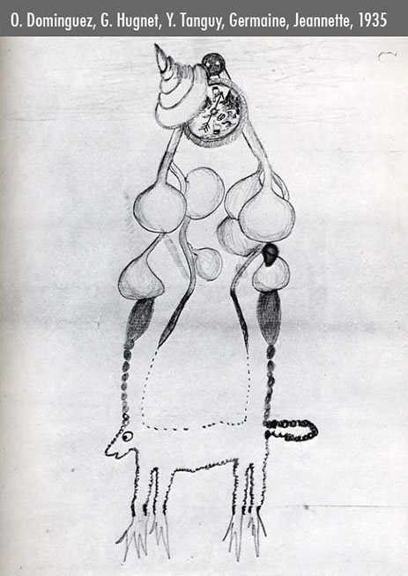
Notes:
http://www.exquisitecorpse.com/images/corpse%20-%2039.jpg?crc=4182065370

Slide 5
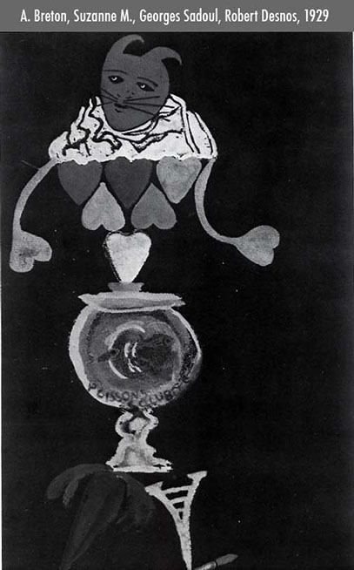
Notes:
http://www.exquisitecorpse.com/images/corpse%20-%2026.jpg?crc=12598517

Slide 6
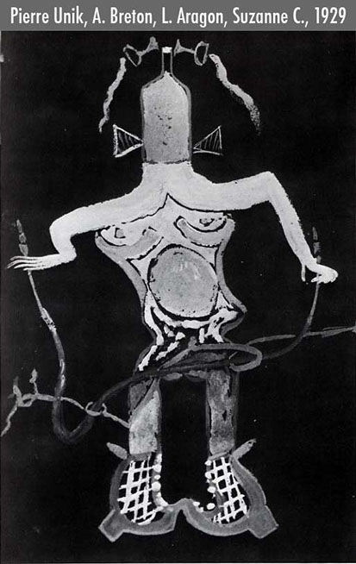
Notes:
http://www.exquisitecorpse.com/images/corpse%20-%2022.jpg?crc=197569989

Slide 7
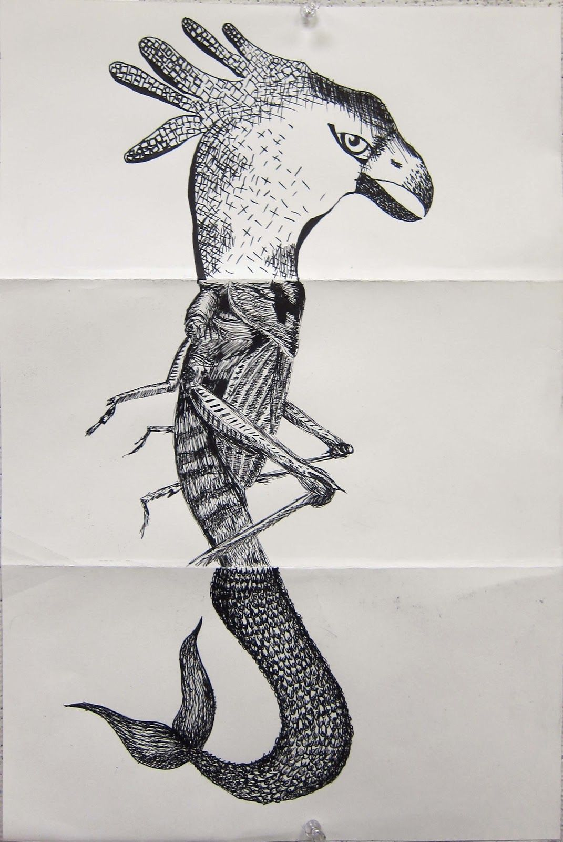
Notes:
https://i.pinimg.com/originals/9a/89/5d/9a895dd79c173062bd57c710693c2351.jpg

Slide 8
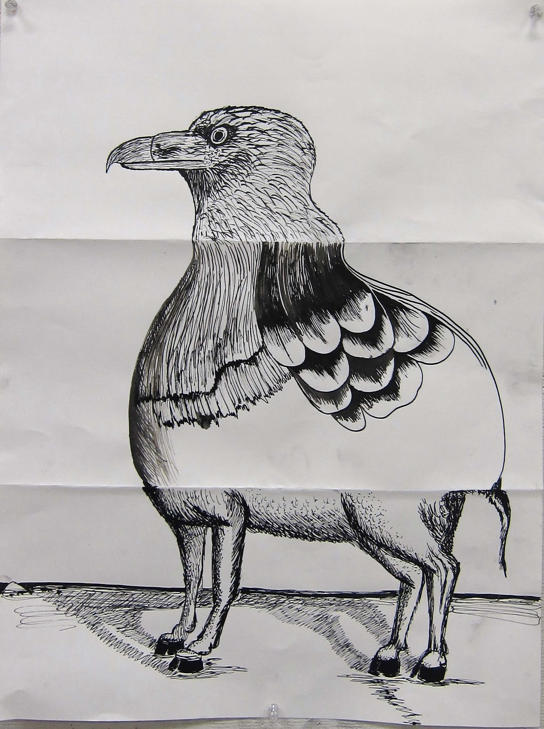
Notes:
https://i.pinimg.com/originals/de/1e/8a/de1e8ab6635a10448dc4f675b4b35e07.jpg

