Slide 1

Chinese Art Motifs

Slide 2
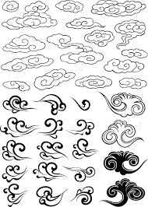
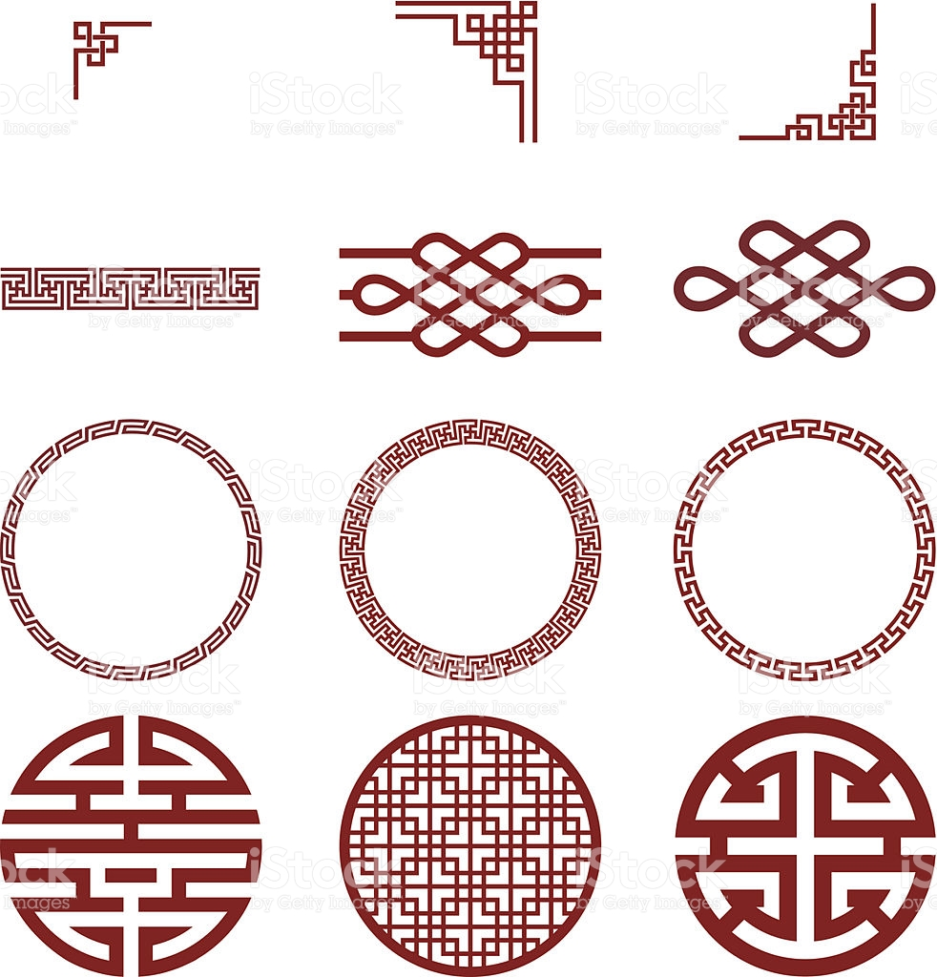
Notes:
https://encrypted-tbn0.gstatic.com/images?q=tbn:ANd9GcQxz8r_4eyA78_yVeRu5AkgdmIiYlKRTFricE0pJ3Jv21E-rIkn
https://media.istockphoto.com/vectors/chinese-paper-and-traditional-pattern-vector-id180877538

Slide 3

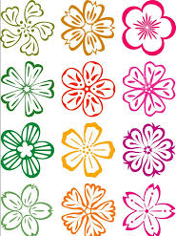
Notes:
https://encrypted-tbn0.gstatic.com/images?q=tbn:ANd9GcTBwxLcetui2_5KkJDvom-NwulVofI4hKk6Ug7HJKC_li6KxVGF
https://previews.123rf.com/images/ongkachakon/ongkachakon1608/ongkachakon160800061/61615198-red-paper-cut-flowers-china-vector-set-design.jpg

