Slide 1
Advertising with posters
How to design a visually persuasive poster
Designed by Karen Stubblefield
AED 410

Slide 2
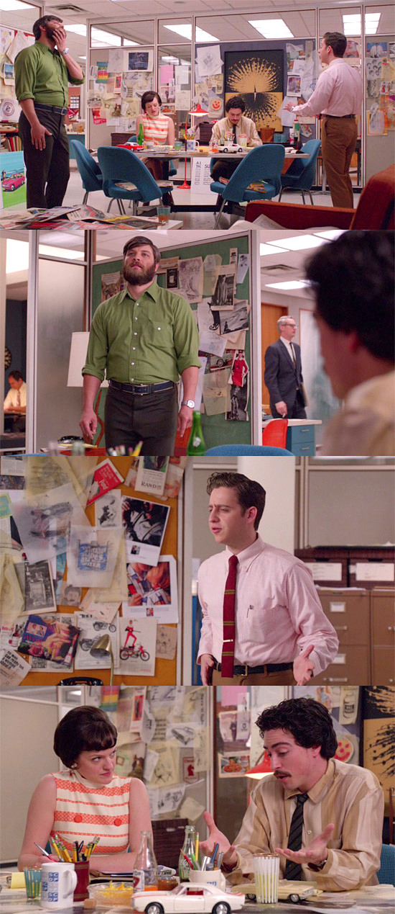
What does an Art Director Do?
The Art Director oversees the artistic film, publication, or other media production.
They are usually in charge of the overall visual design of a concept.
Notes:
http://wpc.4d27.edgecastcdn.net/004D27/2013/MadMen/MadStyleS6E8/MadStyle+S6E8+13.jpg

Slide 3


Can you guess what this poster is advertising?
How about this one?
Notes:
Toulouse-Lautrec, Moulin Rouge (1891): https://media.licdn.com/mpr/mpr/shrinknp_800_800/AAEAAQAAAAAAAAP6AAAAJDFiNGJlOTBhLTcwNmEtNDY3Mi05YjAxLTQ4YjM5MjY2ZjJiMA.jpg
Coffee: https://s-media-cache-ak0.pinimg.com/736x/95/5b/8a/955b8a3bb947902fbd0784260ad4f122.jpg

Slide 4

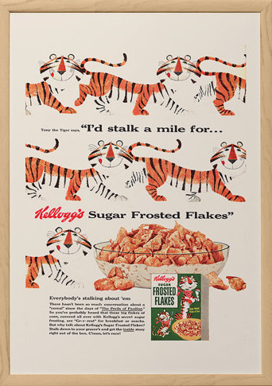
What makes a poster persuasive?
Notes:
Jello: https://img1.etsystatic.com/061/0/9537835/il_570xN.778626401_p0tv.jpg
FF: https://img1.etsystatic.com/064/0/9537835/il_fullxfull.776282007_s90u.jpg

Slide 5



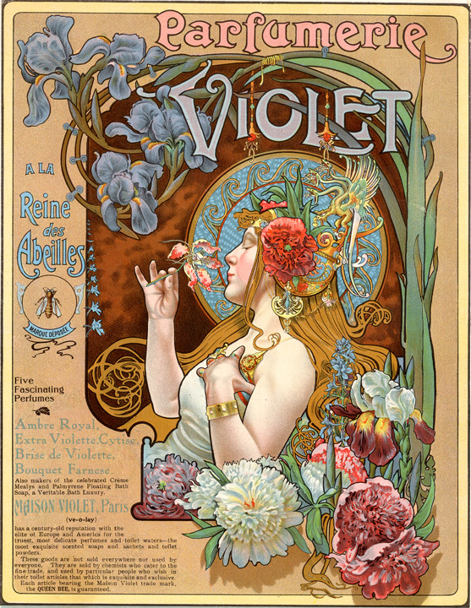
Let’s take a look…
Notes:
Hoover: https://s-media-cache-ak0.pinimg.com/564x/90/7b/84/907b844b633f369b8c2b834ea5211286.jpg
Miel: https://s-media-cache-ak0.pinimg.com/564x/83/52/de/8352de060bd1d1c1aa288b663f61f5e4.jpg
Pierrot: https://s-media-cache-ak0.pinimg.com/originals/36/59/2b/36592b12d803b4c44127ee43f1a304a0.jpg
Art Nouveau: https://s-media-cache-ak0.pinimg.com/564x/57/a5/10/57a5108546a83279b74e46102dcc36f8.jpg

Slide 6

What did you notice?
What direction are the posters?
How does the artist use the paper? Are the images using only a small part of the paper or a large part of the paper?
  What effect does this create?
  Do you think the posters are persuasive?
This is an advertisement for a famous venue called the Black Cat, by Theophile Steinlen
Notes:
https://www.amazon.com/Steinlein-Chat-Poster-Print-36-Inch/dp/B000NVYYR6

Slide 7

You will be making your own Posters
These are “Fauxsters” from illustrator Bob Staake
Notes:
Bob Staake: http://www.fayeandco.com/wp-content/uploads/2008/12/picture-24.png

Slide 8


What are Unsuccessful examples of posters?
Notes:
(right) https://dylandaviduk.files.wordpress.com/2013/02/bad3.png
(left) https://s-media-cache-ak0.pinimg.com/564x/98/4d/70/984d7041238150b85b75aef345dd55cf.jpg

