Slide 1
Tibetan Prayer Flags
Notes:
http://www.newint.com.au/shop/img/2209-900x500.jpg

Slide 2
What are they?
A 2000 year old Tibetan tradition
Symbols of good-fortune and hope
Each flag is printed with images and words that promote a different virtue (an act of goodness)
Notes:
http://www.thepeaceflagproject.org/historyoftibetanflags.htm

Slide 3
Why are they used?
When hung, they are believed to bring peace and harmony to those nearby.
The wind is thought to “carry” the well-wishes across the flag’s surroundings.
Originally hung over mountain passes and rivers to benefit all who passed underneath.
Notes:
http://www.thepeaceflagproject.org/historyoftibetanflags.htm

Slide 4
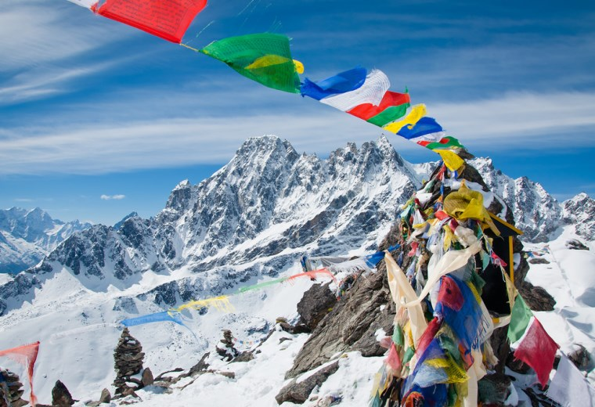
Interesting Fact
Many climbers leave these flags at the summit of Mount Everest so the wind can spread goodness to all.
Notes:
http://media.dreamplango.com/resources/dpg/760x520/2b0cc395-2e2a-4bea-8bbd-481ffe6fb7da.jpg

Slide 5
Meaning of Colors
Nature elements and virtues:
Blue→Sky & Peace
White→Wind & Purification
Red→Fire & Compassion
Green→Water & Prosperity
Yellow→Earth & Knowledge
Notes:
https://owlcation.com/humanities/Tibetan-Prayer-Flags

Slide 6
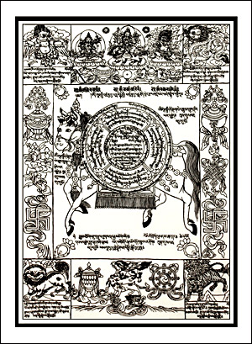
Symbolism
Animal and mythical creatures also carry meaning.
The Wind Horse is a common figure. It symbolizes the idea of well-being or good fortune.
Notes:
http://www.prayerflags.com/images/products/tPF-1si.jpg

Slide 7
How many virtues can you think of for your community?

