Slide 1
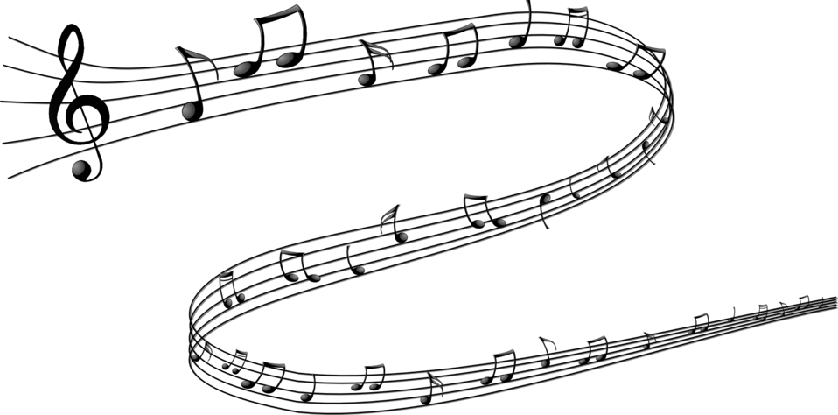
Romare Bearden Collages
Visualizing Music
Notes:
http://www.mmoca.org/sites/default/files/images-mmoca-collects/lessons/0101_0.jpg

Slide 2
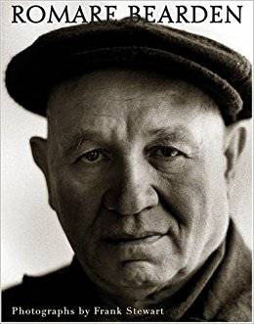
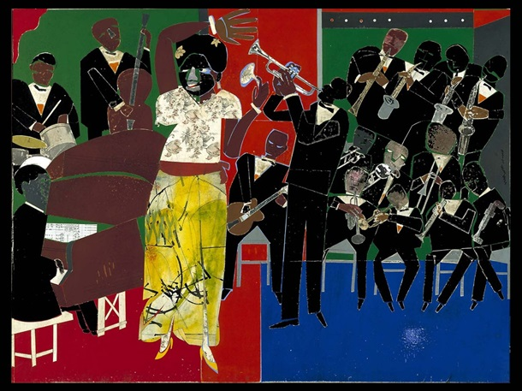
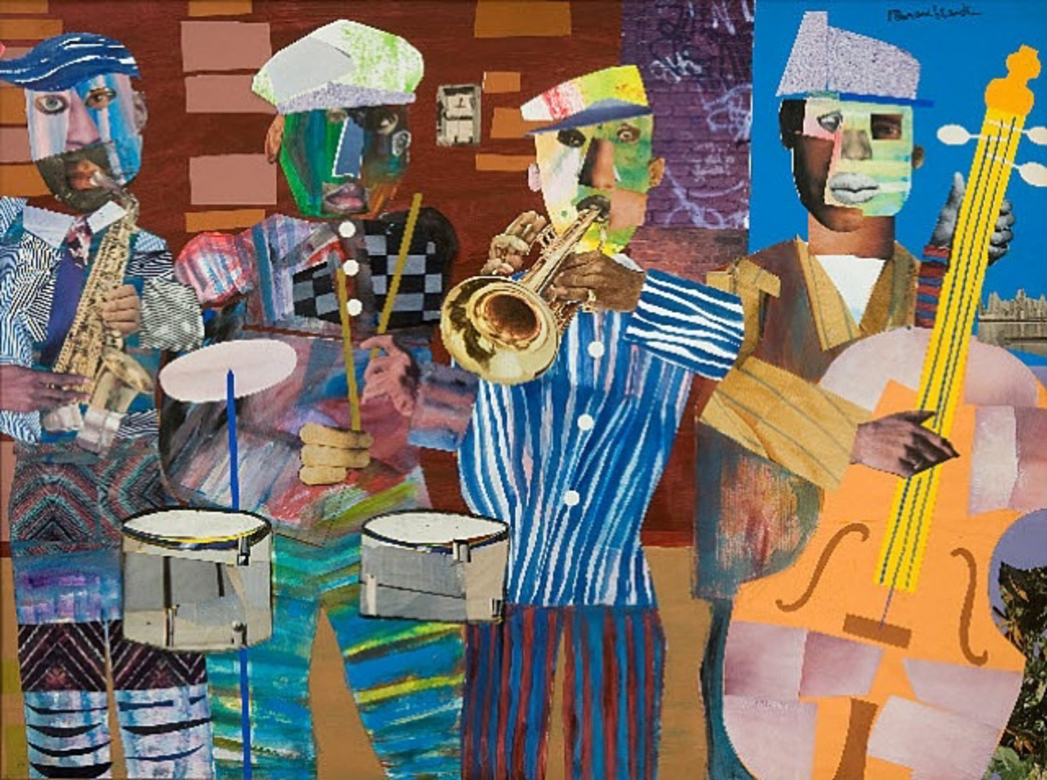
About the Artist
Romare Bearden
African American artist
  Started as a painter but is most famous for his collages
He was born in North Carolina but grew up in New York City
Inspired by his community and jazz music
Notes:
Romare Bearden, Jazz Village
https://artsedge.kennedy-center.org/~/media/ArtsEdge/Images/Articles/Students/features/hear-with-your-eyes/bearden-empress-of-the-blues.jpg?as=1&dmc=0&w=610

Slide 3
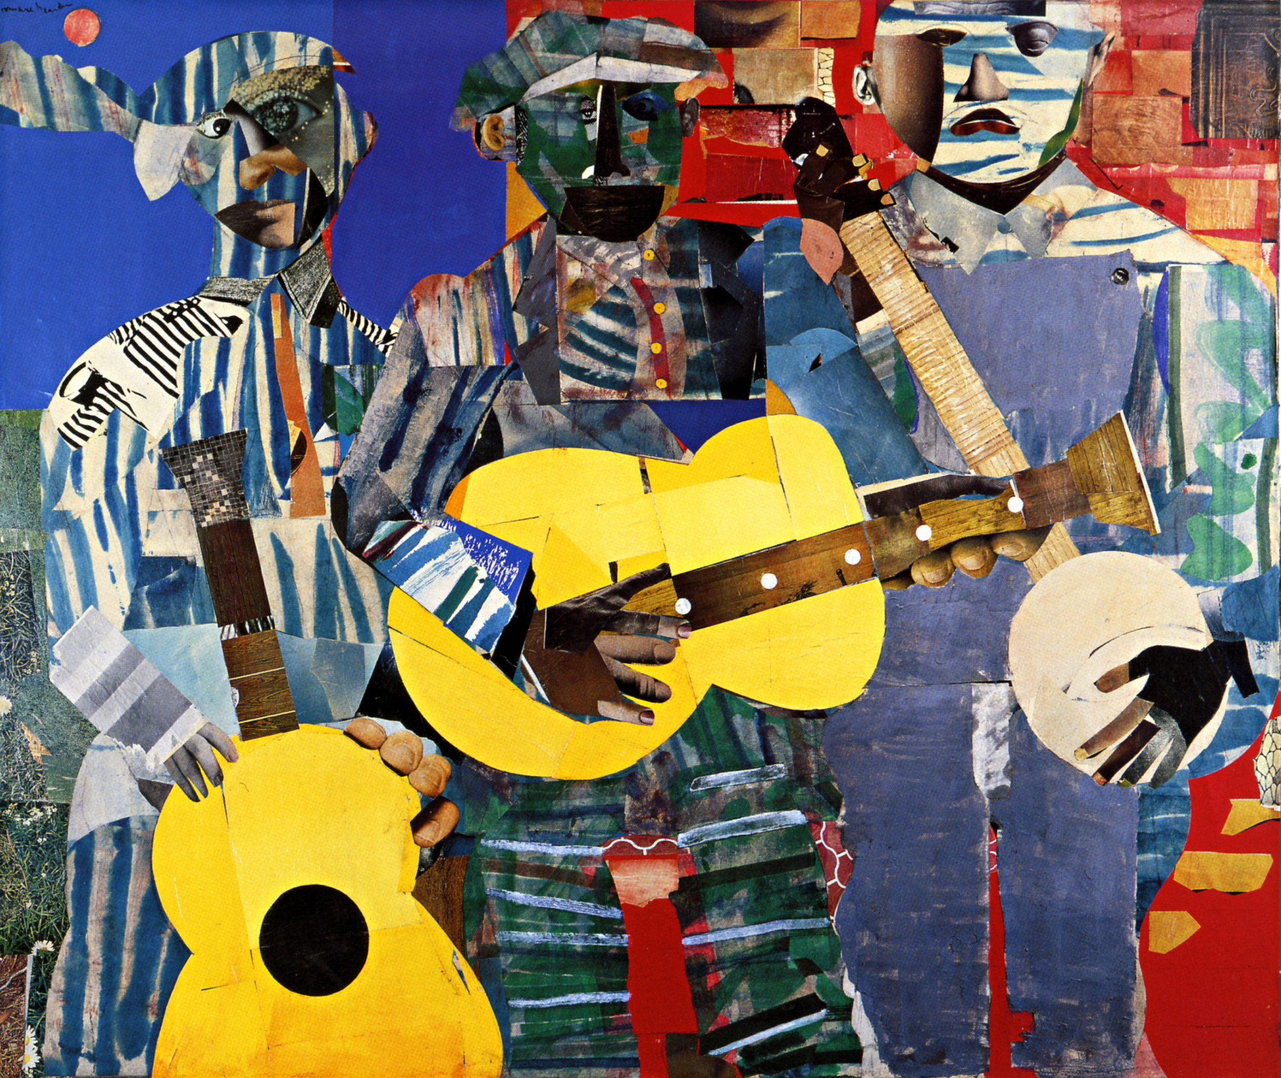
How does Bearden show Rhythm and Variety?
Rhythm
Shows motion through use of line, color, shapes, texture
Variety
Different types of line, color combinations, shapes, and textures
Romare Bearden, Three Folk Musicians

