Slide 1

Line Portraits
Alexander Calder and Salventius

Slide 2
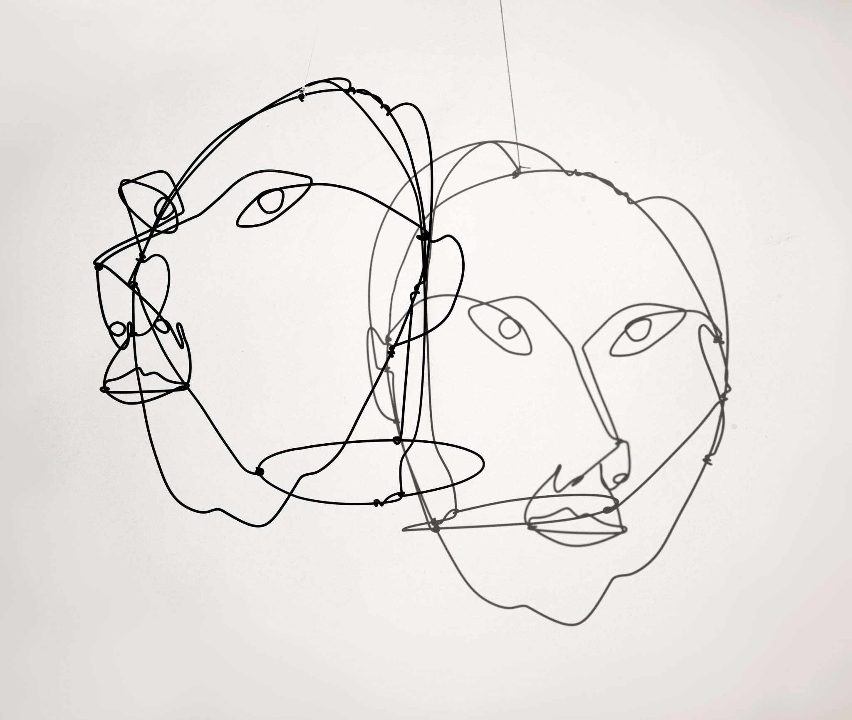
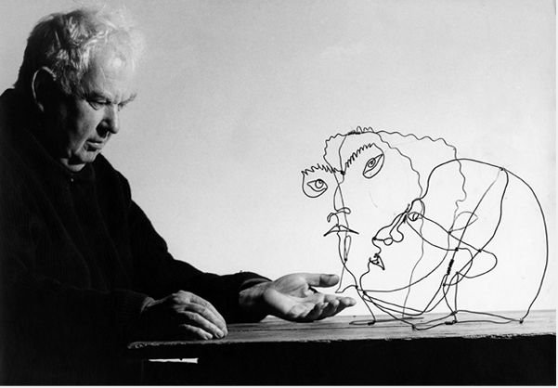
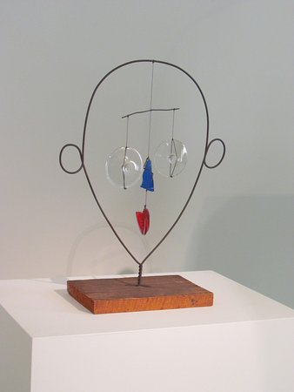
Who is Alexander Calder?
He was an Abstract Expressionist artist born in 1898.
He made mobiles--artwork that hung from ceilings--and wire sculptures
Notes:
Image from http://anoukyve.com/wp-content/uploads/2016/06/alexander-calder-portrait-of-giovanni-carandente-1967-wire-44-x-32-x-50-cm-calder-foundation-licensed-by-dacs-uk-courtesy-ronchini-gallery-and-museo-carandente-palazzo-collicola.jpg
https://media-cdn.tripadvisor.com/media/photo-s/0d/aa/10/71/alexander-calder-mobile.jpg
http://www.tate.org.uk/sites/default/files/styles/width-1200/public/images/calder-portraits-c-1930.jpg

Slide 3
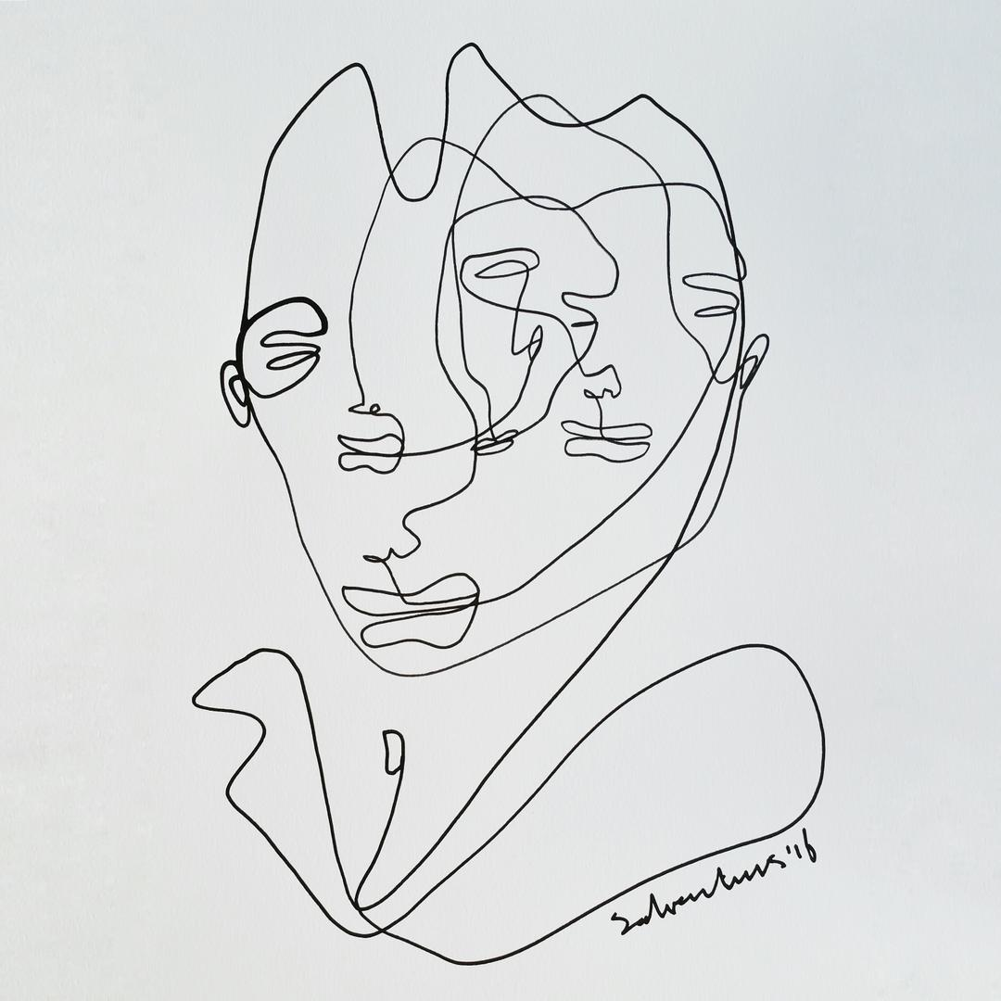
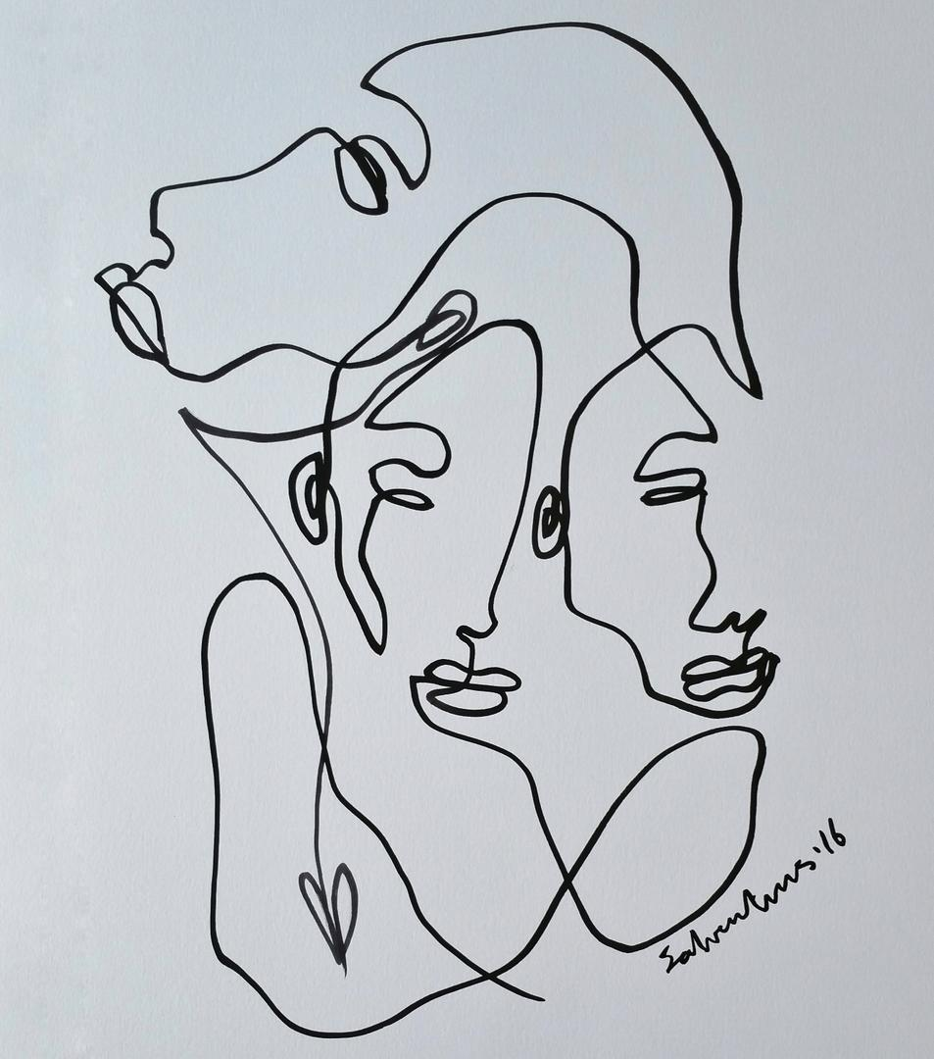
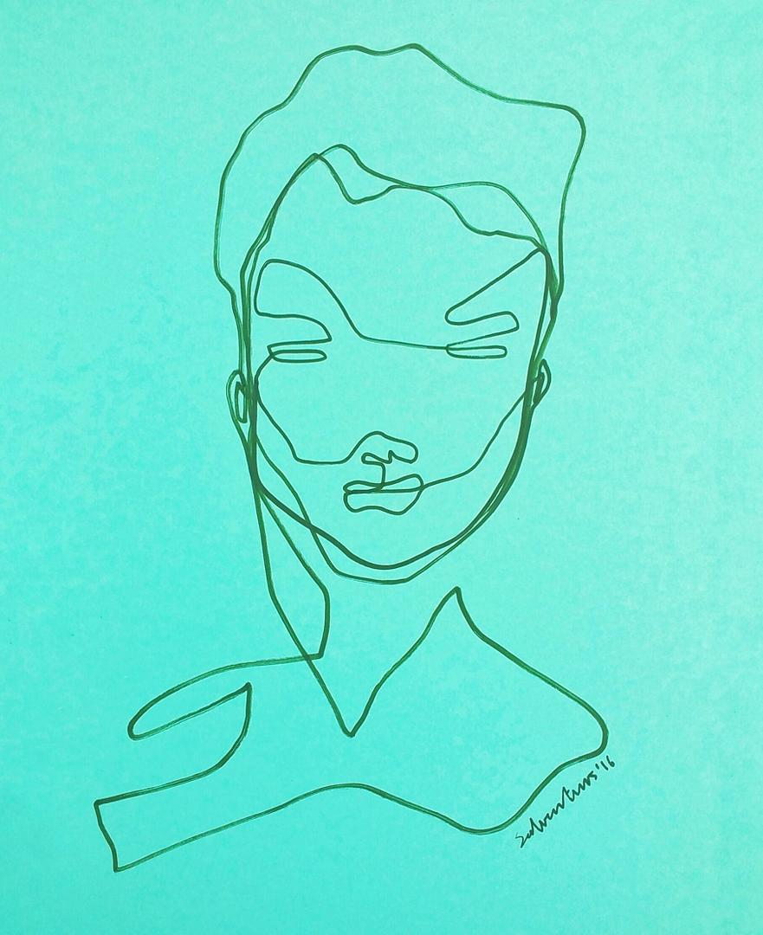
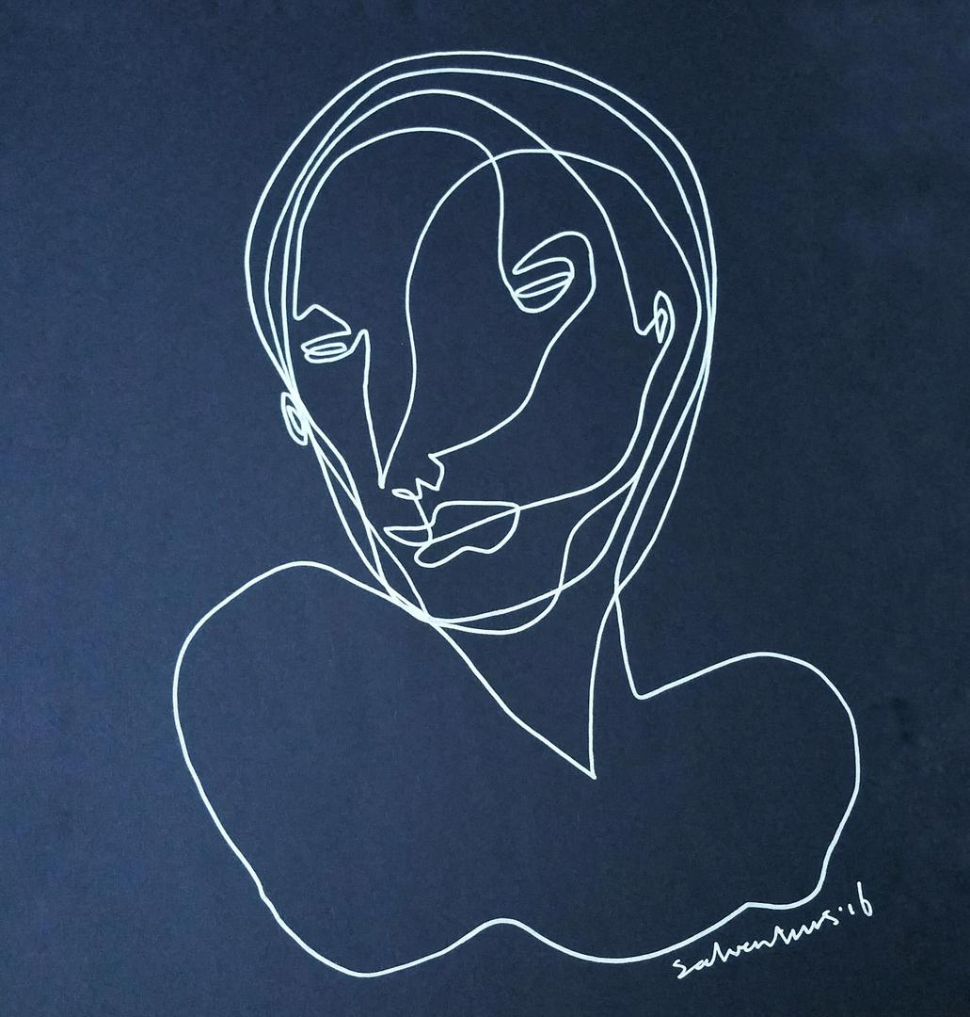
These are line drawings by a Dutch artist named Salventius; he makes continuous contour line drawings.
Notes:
Images from http://salventius.com/

Slide 4
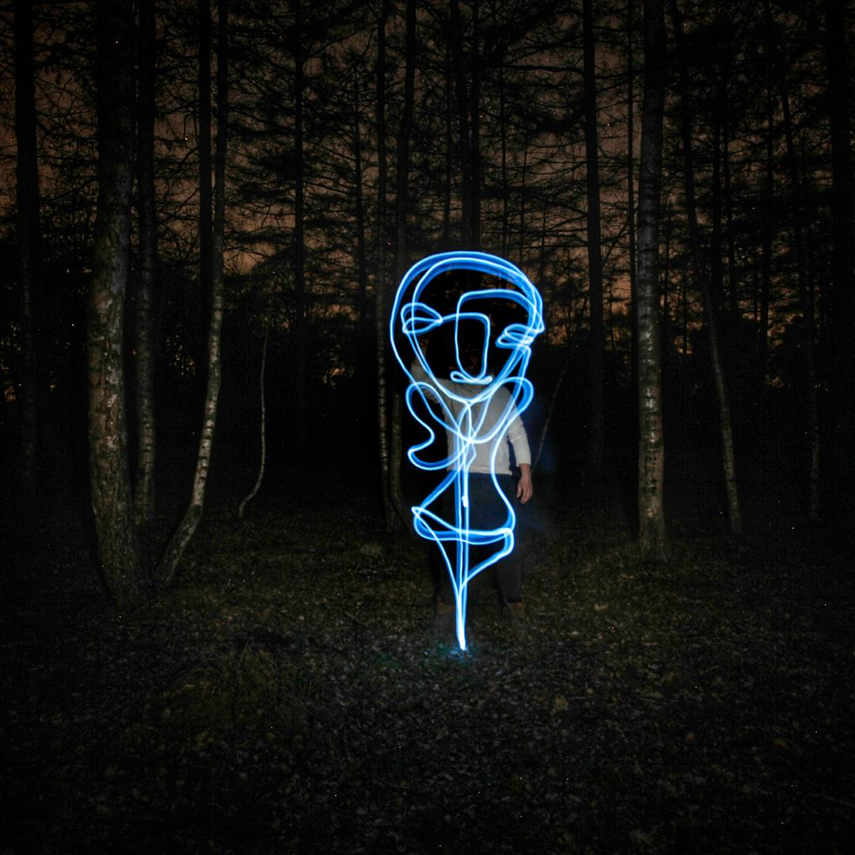
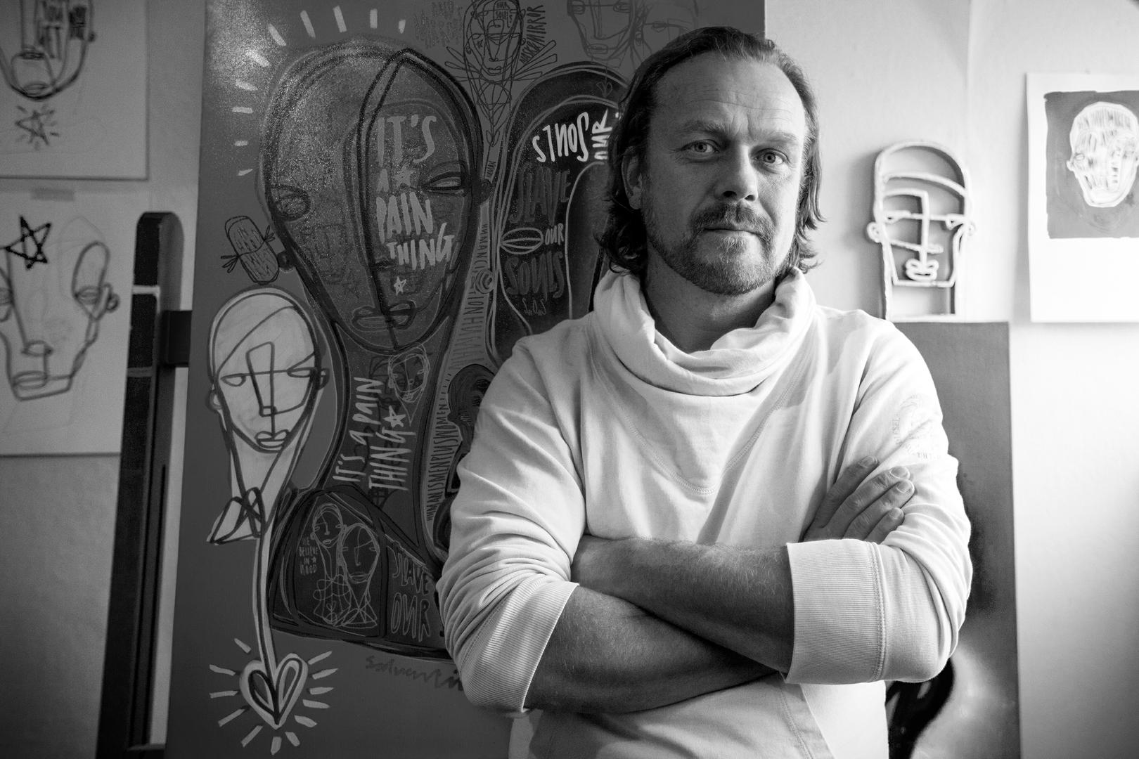
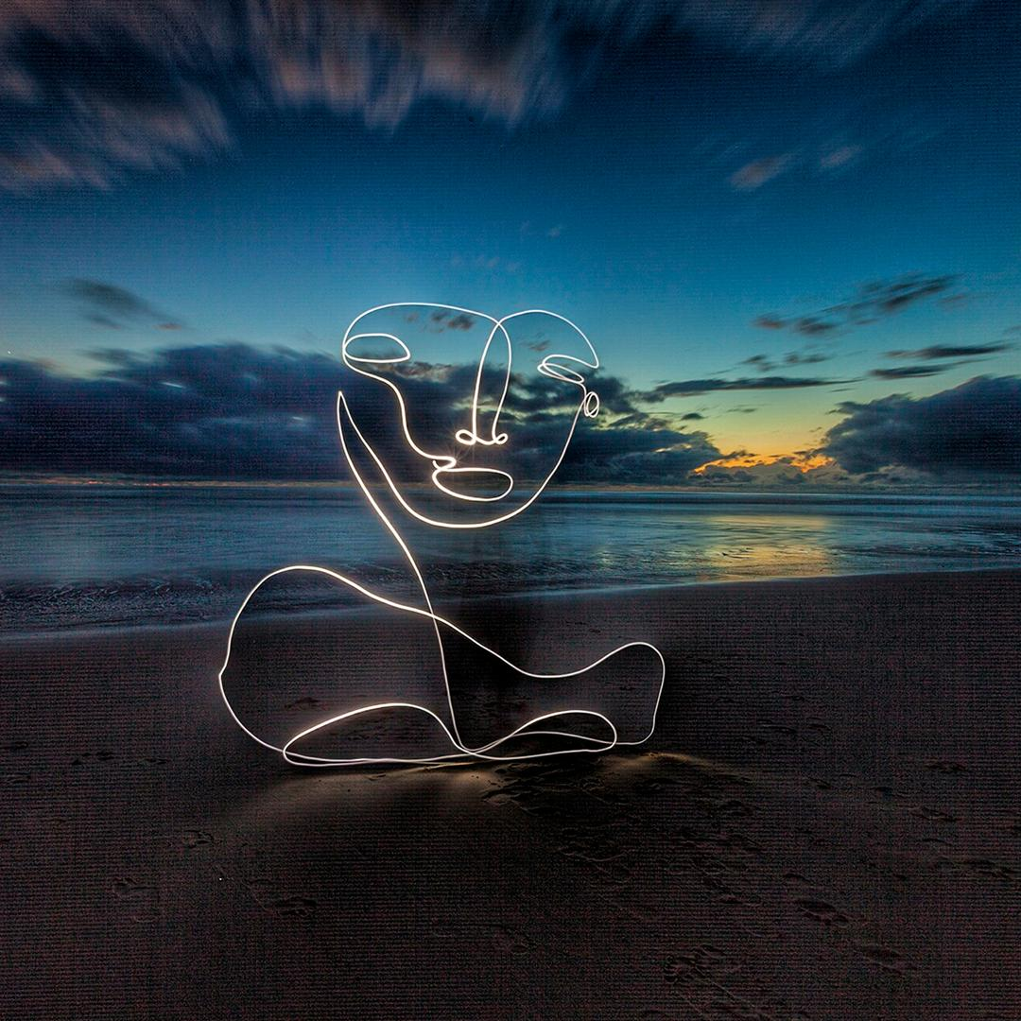
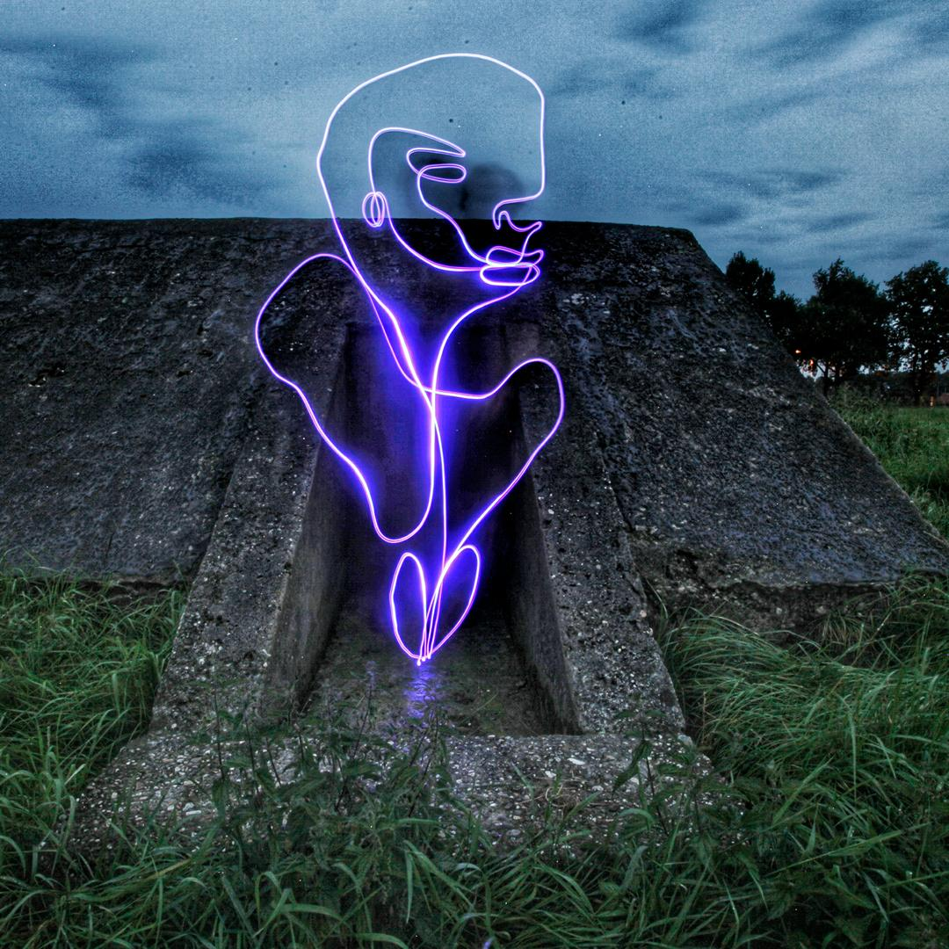
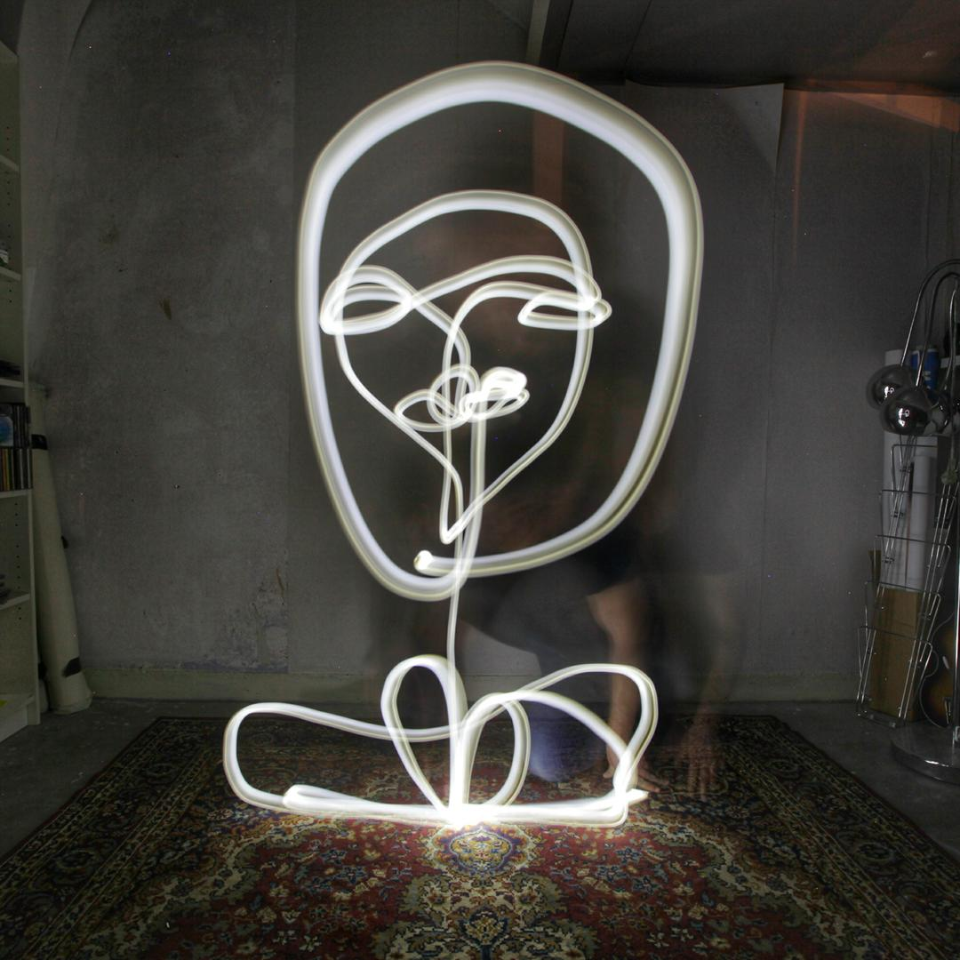
Salventius also draws using light!

Slide 5
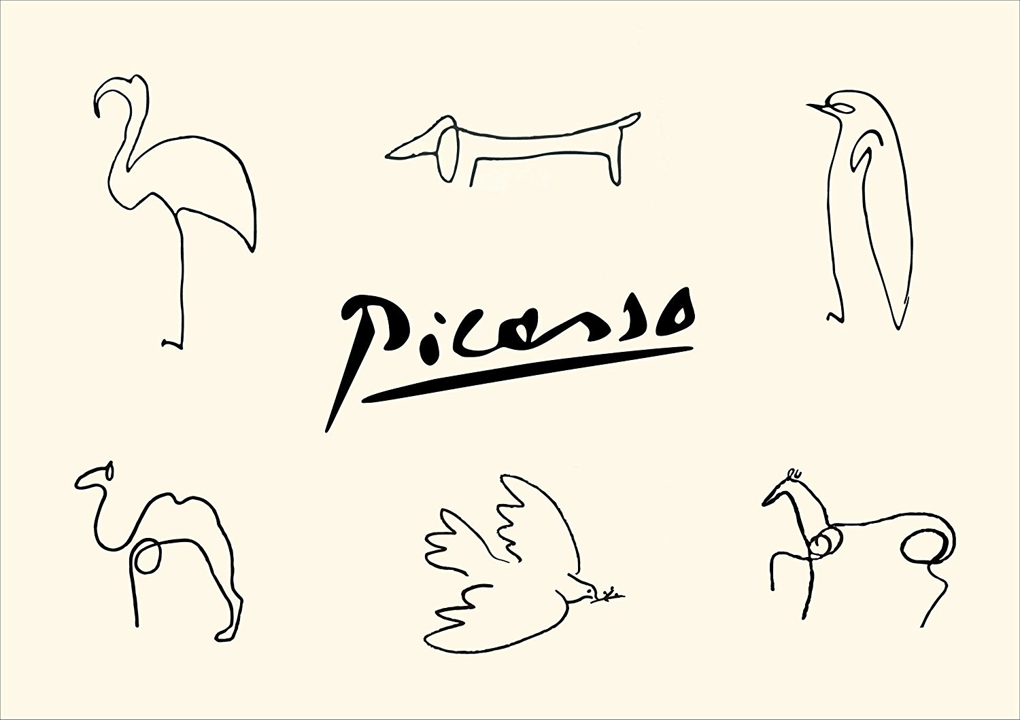
Picasso Line Drawings
Notes:
https://img.etsystatic.com/il/325aeb/1179862463/il_fullxfull.1179862463_n3d3.jpg

Slide 6
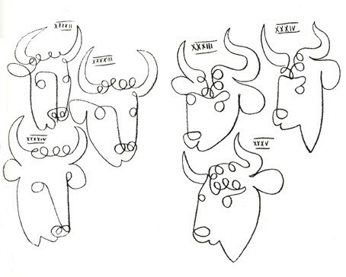
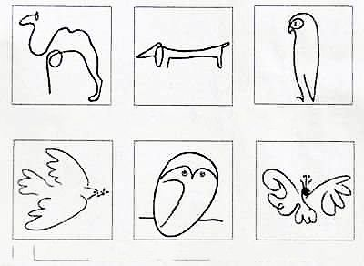
Notes:
https://elumina.me/wp-content/uploads/2017/07/elumina-inspiration-one-line-picasso-drawings-bulls-animals.jpg
https://i.pinimg.com/474x/fd/c1/ed/fdc1eda7dc1303cdda71ad45c6690224--picasso-drawing-pablo-picasso.jpg

Slide 7
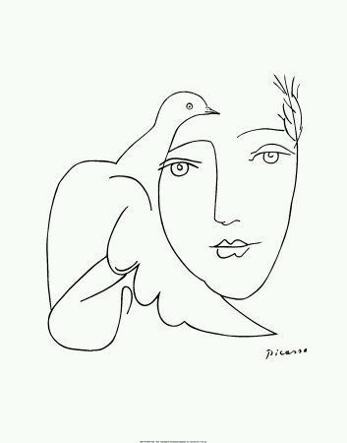
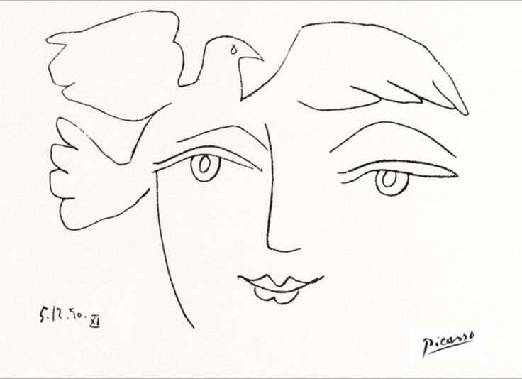
Notes:
https://78.media.tumblr.com/72dfc23f258c8bf35994270e952c5bbc/tumblr_nnsenq6rjR1s6gnx2o1_400.jpg
http://www.saturaterecords.info/wp-content/uploads/pablo-picasso-line-art-best-25-picasso-drawing-ideas-on-pinterest-picasso-sketches.jpg

Slide 8
Compare and Contrast
Do you see similarities in the works by Calder and Saleventius? How about differences?
Calder
Saleventius

Slide 9
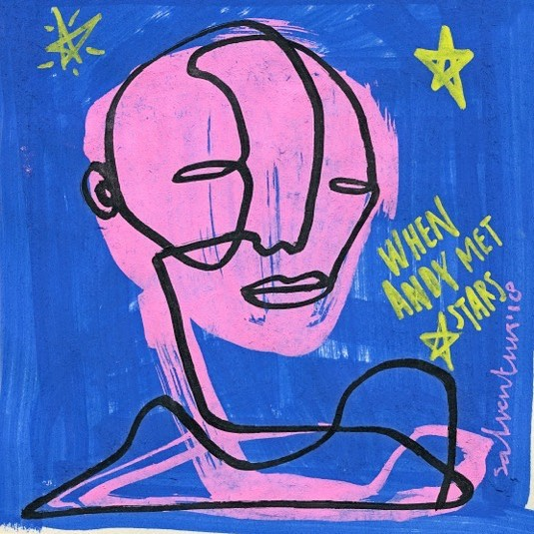
Notes:
Salventius, When Andy Met Stars,
https://scontent-lga3-1.cdninstagram.com/vp/332a2c475aaa18efd68481ac5c3e4505/5B2094E2/t51.2885-15/e35/26332114_1922889131361633_4313318806492545024_n.jpg

