Slide 1

Ansel Adams
Nature Landscapes

Slide 2
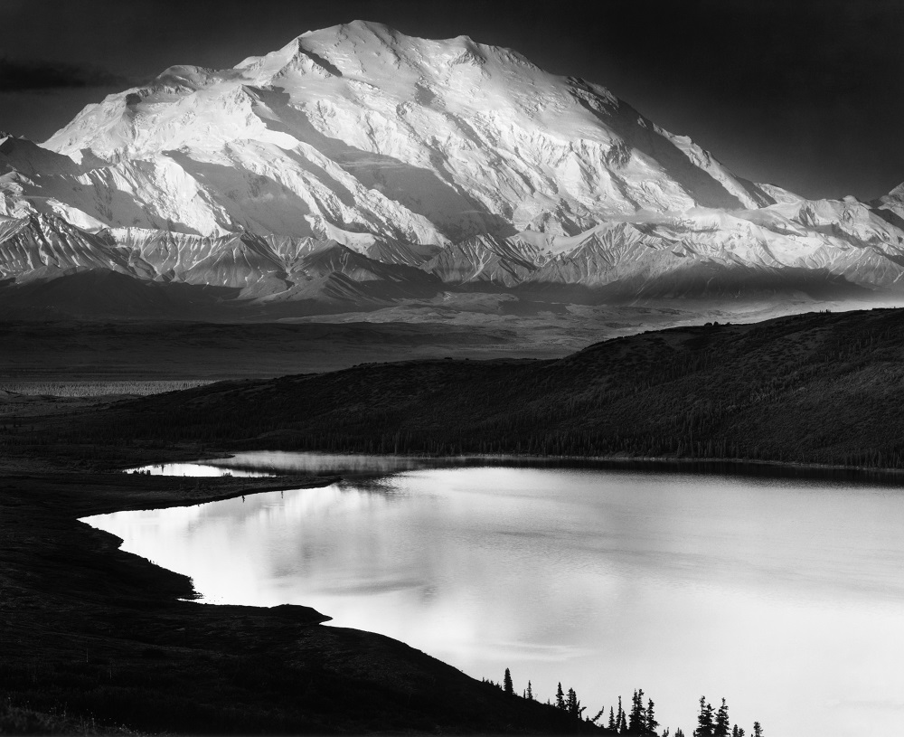
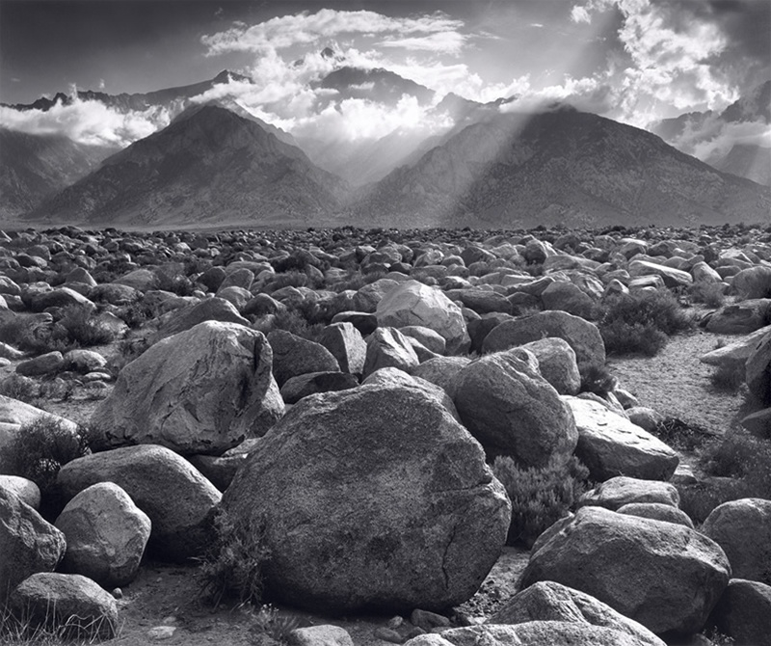
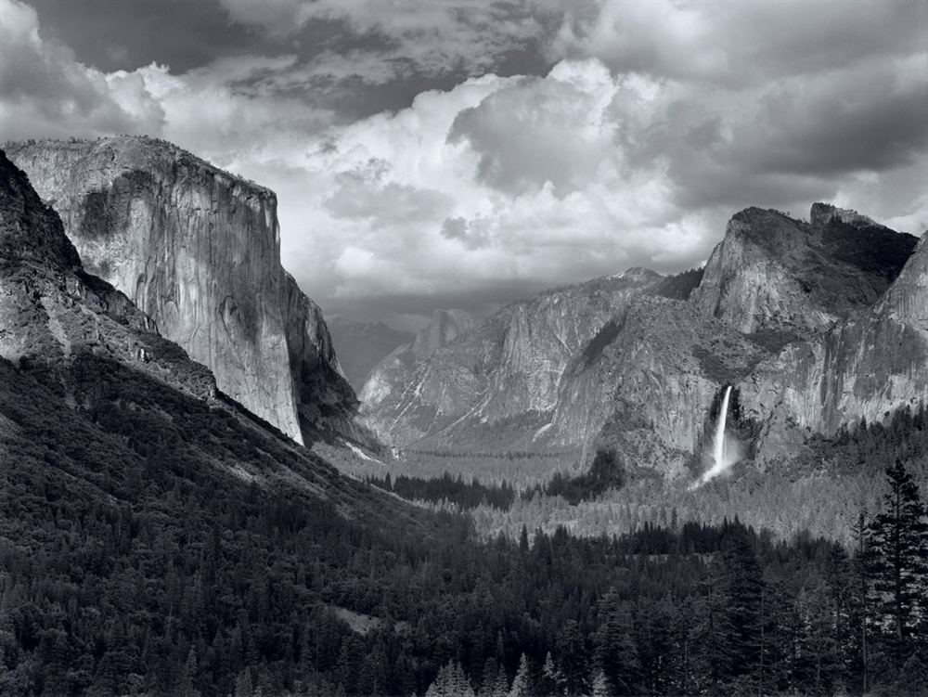
Who was Ansel Adams?
An American photographer born in San Francisco in 1902.
He was also a noted environmentalist
His photographs often showed the grandeur and beauty of the American landscape, especially its National Parks.
Have you been to a National Park?
Notes:
Images from www.anseladams.com

Slide 3
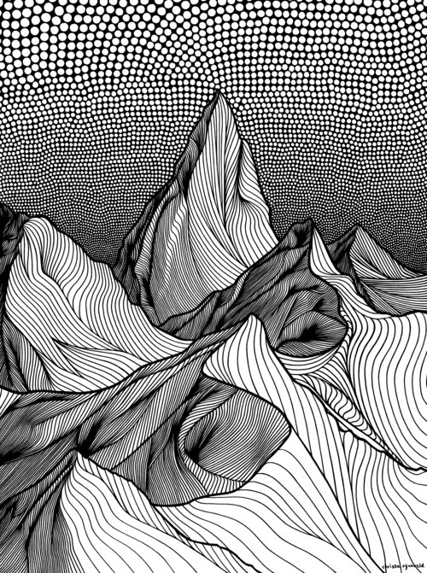
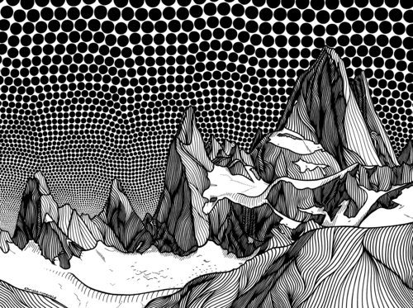
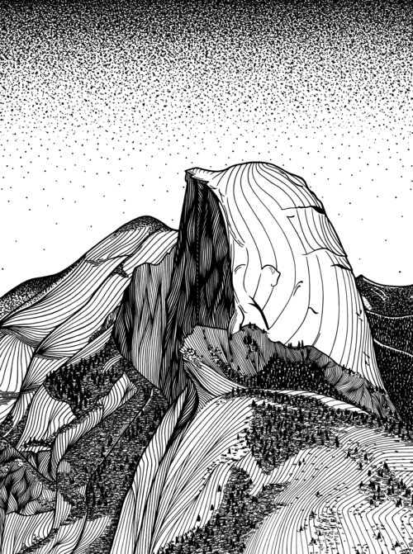
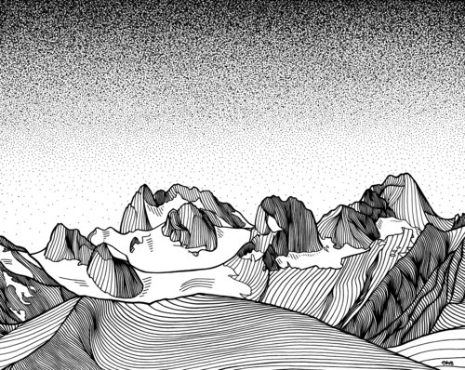
These ink drawings are made by Dutch artist Christa Rijnevald, she currently lives in Canada.
Notes:
Images from https://www.christarijneveld.com/

Slide 4
Compare and Contrast
What is similar between Ansel Adams and Christa Rijnevald’s works? What is different?

Slide 5
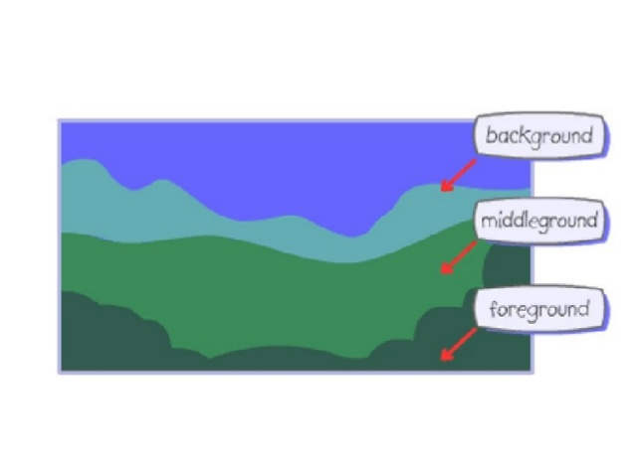
Landscape Composition Review

