Slide 1
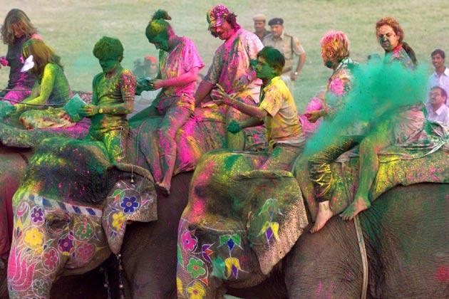
Notes:
http://img01.ibnlive.in/ibnlive/uploads/2012/03/holi12.jpg

Slide 2
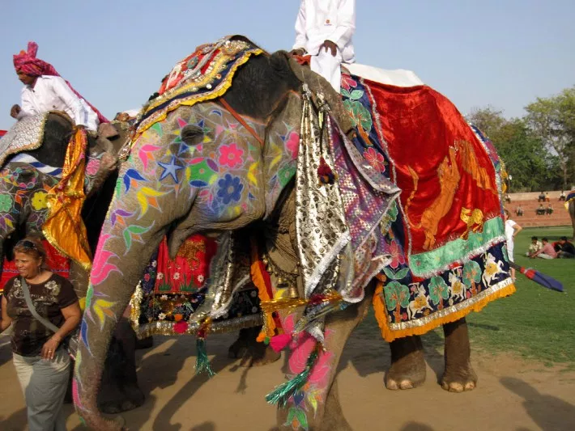
Notes:
https://i2.wp.com/shannonodonnell.smugmug.com/South-Asia/India/33531227939a240e65cbo/1048363225_2aFud-XL.jpg?resize=710%2C533

Slide 3
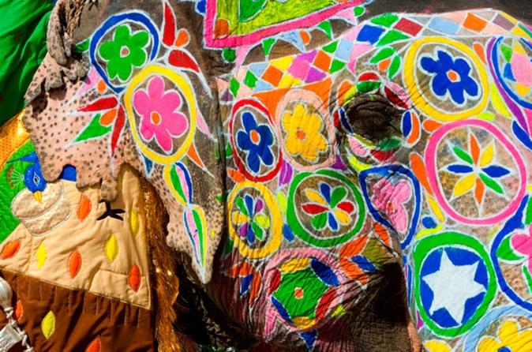
Notes:
https://cache-graphicslib.viator.com/graphicslib/thumbs674x446/8209/SITours/2-night-jaipur-including-elephant-ride-from-new-delhi-in-new-delhi-263995.jpg

Slide 4
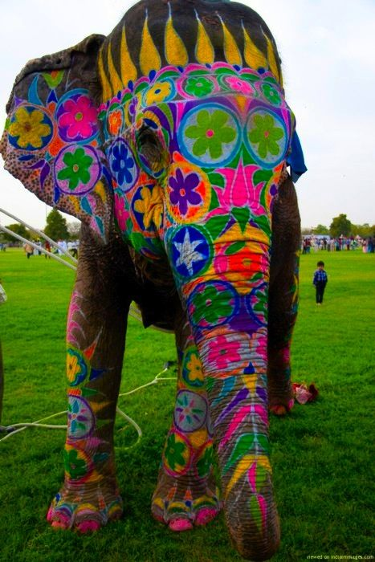
Notes:
https://data.whicdn.com/images/103838750/original.jpg

