Slide 1

Guatemalan Worry Dolls

Slide 2
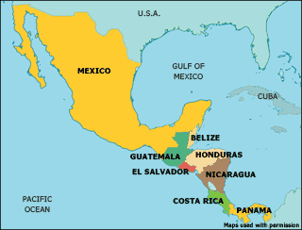

Guatemala is located in Central America. Its neighbors are Mexico, Honduras, Belize, and El Salvador.

Slide 3
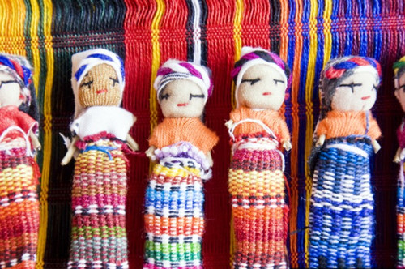
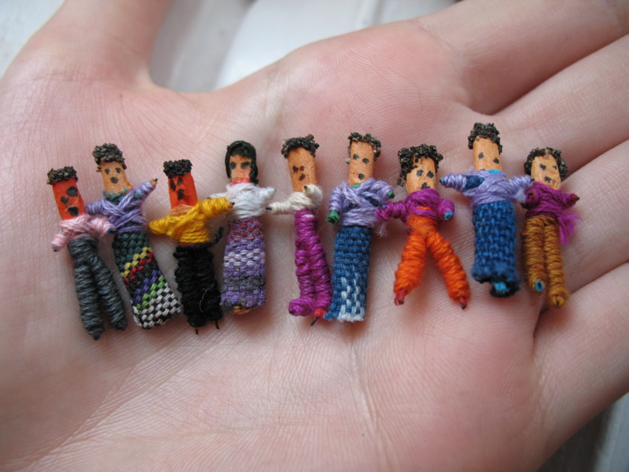
What are Worry Dolls?
The indigenous people from the Highlands in Guatemala created Worry Dolls many generations ago as a cure for worrying.
According to the Mayan legend, when worrying keeps a person awake, he or she tells a worry to as many dolls as necessary.
Notes:
http://fotologimg.s3.amazonaws.com/photo/59/48/115/nanibonica/1265305787146_f.jpg
https://upload.wikimedia.org/wikipedia/commons/c/ca/Worry_dolls.jpg

Slide 4
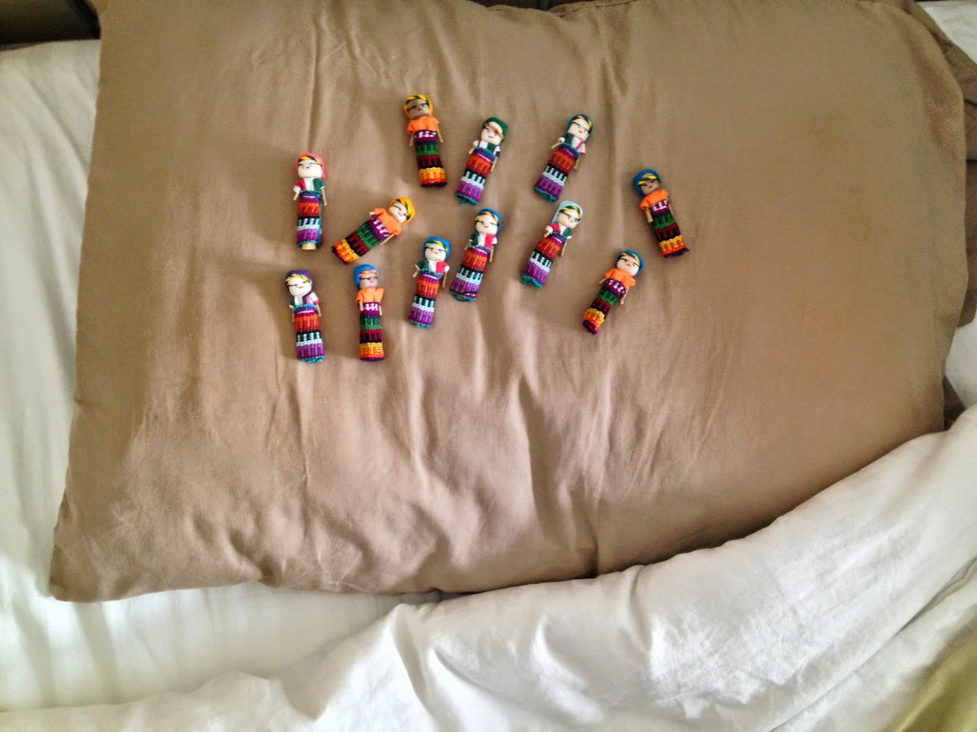
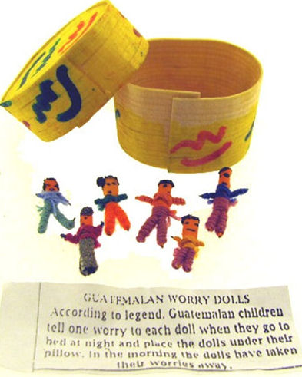
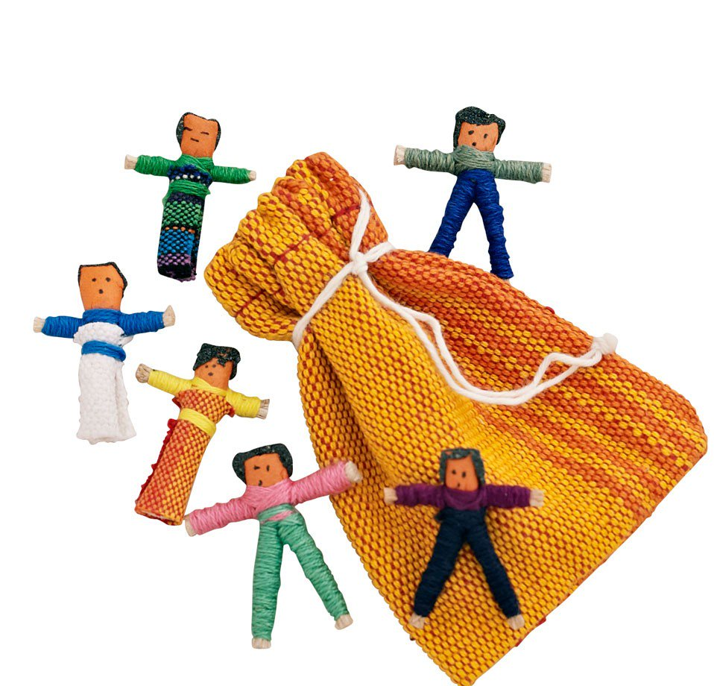
Then...
the worrier places the dolls under his or her pillow. The dolls take over the worrying for the person who then sleeps peacefully through the night. When morning breaks, the person awakens without the worries that the dolls took away during the night.
Another version of the legend tells a person to tell the dolls her worries then place them in their cloth pouch or wooden box before going to bed.
Notes:
http://4.bp.blogspot.com/-mN8YH9zcDUo/U62cQVIbY8I/AAAAAAAAEAQ/SWvgoBV6deM/s1600/IMG_1822.JPG
https://www.tenthousandvillages.com/media/catalog/product/cache/1/image/9df78eab33525d08d6e5fb8d27136e95/8/8/8801060_1_1.jpg
https://www.knightdiscounts.com/Wholesale/worrydollsinabox.jpg

Slide 5

Notes:
http://frommayanhands.com/wp-content/uploads/BUNDLE_WorryDoll2.jpg

